Slide 1
AS91903 USE COMPLEX TECHNIQUES TO DEVELOP A DIGITAL MEDIA OUTCOME
ACHIEVEMENT
ACHIEVEMENT
WITH MERIT
ACHIEVEMENT
WITH EXCELLENCE
Use complex techniques to develop a digital media outcome.
Use complex techniques to develop an informed digital media outcome.
Use complex techniques to develop a refined digital media outcome.

Slide 2
AS91906 USE COMPLEX PROGRAMMING TECHNIQUES TO DEVELOP A COMPUTER PROGRAM
ACHIEVEMENT
ACHIEVEMENT
WITH MERIT
ACHIEVEMENT
WITH EXCELLENCE
Use complex programming techniques to develop a computer program.
Use complex programming techniques to develop an informed computer program.
Use complex programming techniques to develop a refined computer program.

Slide 3
CONCEPT : PLANNING

Slide 4
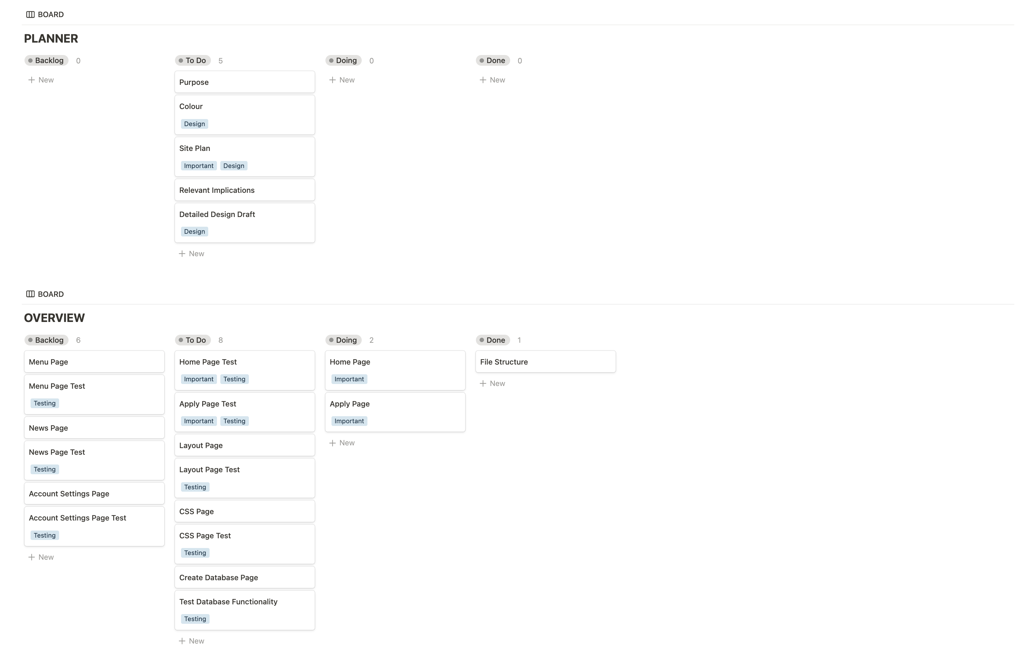
PLANNING

Slide 5
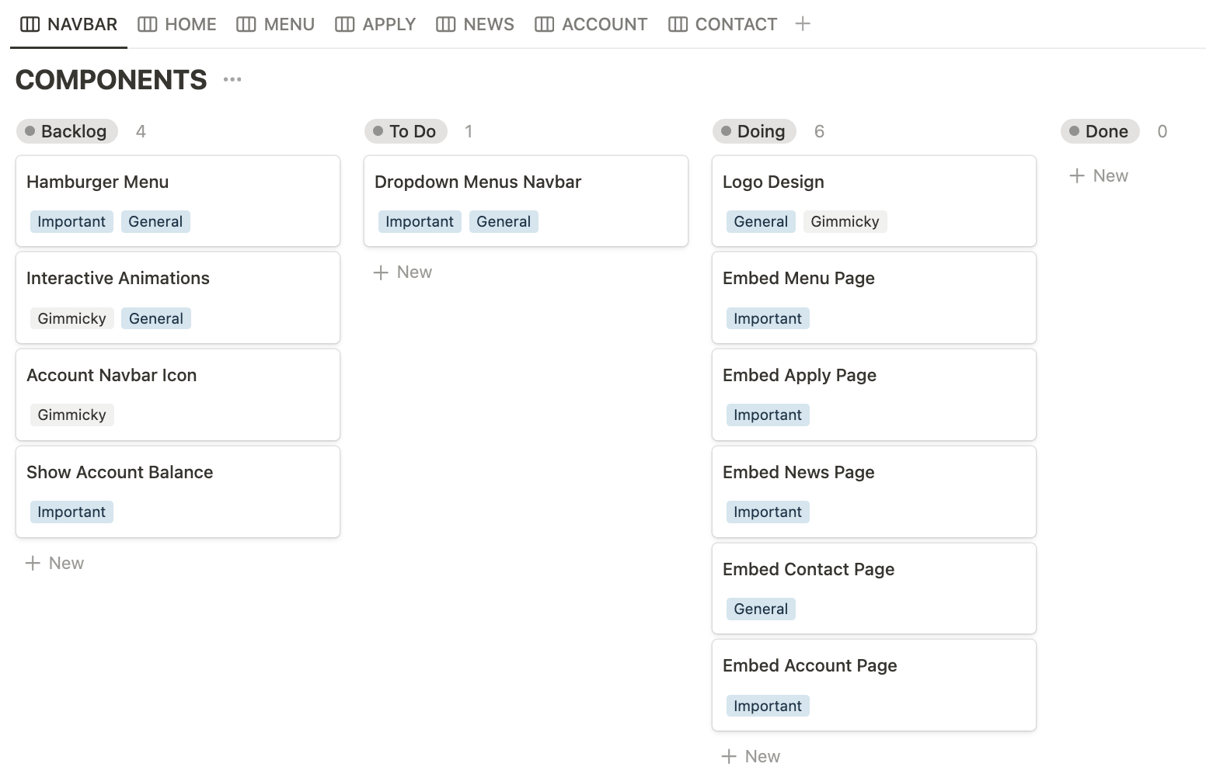
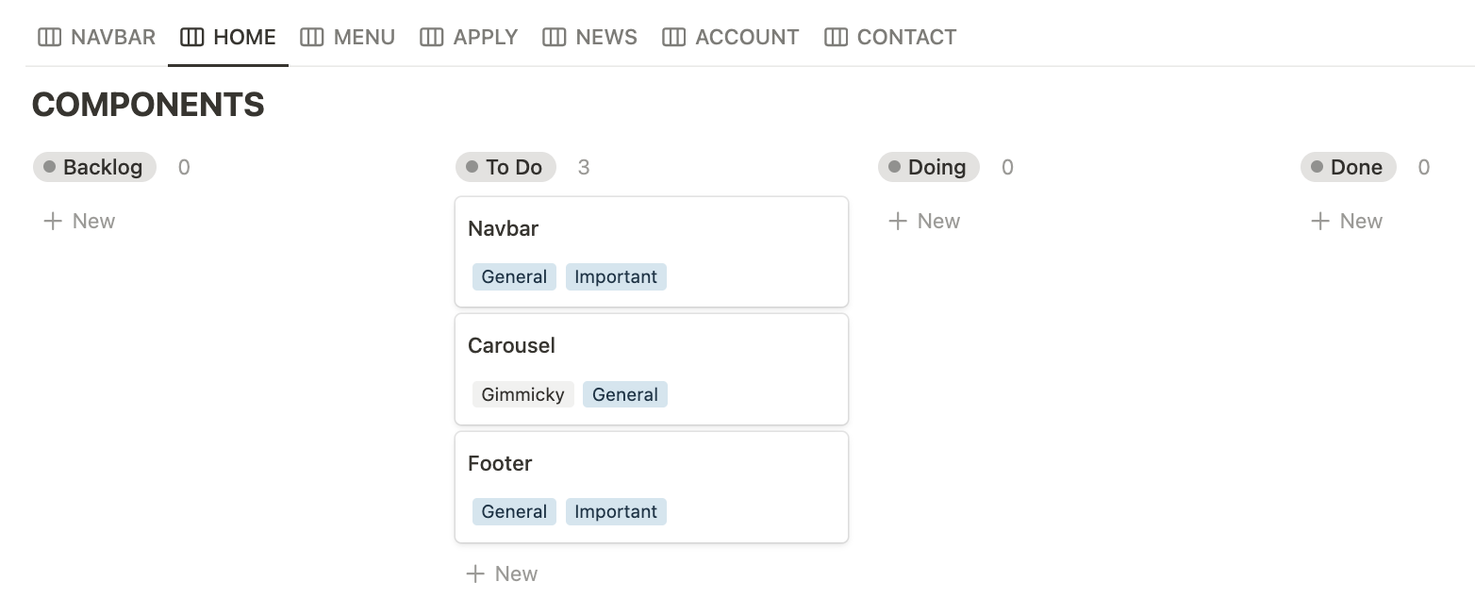
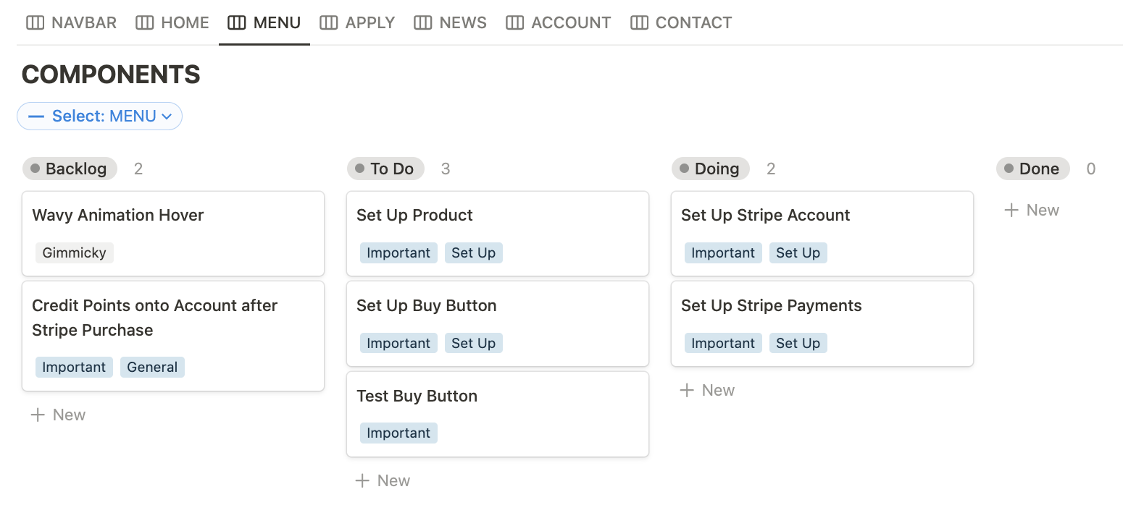
To manage my digital outcome, I use a Kanban board system in segments, specifically on Notion, to make this project digestible. On the left are a few examples of my Kanban boards for each sub-component that makes the whole website. This helps me define checkpoints and requirements to effectively and efficiently complete my digital outcome.
To measure my progress, I must establish the requirements and checkpoints. As a placeholder for my database and other information, I will then create the bare-bones front end using HTML, CSS, and JS. Then, using Python and SQL, I can create databases. Through thorough testing, I can validate the functionality of every feature and use user feedback to tailor it to their needs. Here I can release the final digital outcome to the Cafeteria department, which the program should be future-proof and is able to be improved on or add additional features.
This approach ensures that the project stays on track and meets the needs of my users as I continue to provide updates to them. I will also use GitHub to publish my work, allowing me to revert to a safe checkpoint if needed.
PLANNING

Slide 6
PURPOSE
This is a website for Sancta Maria College's Compass Café. The website's intentions are to allow users to apply as baristas for lunchtime duties, improving on the current limited system the cafeteria has by digitalising it. Digitalising the process allows staff to manage the system better, therefore addresses the problem of students being absent during their designated duty periods. By simplifying or adding features to make the process easier, the website experience can run more smoothly and reliably – students will be held more accountable to stay on duty and hence making the system dependable. Moreover, the digital platform grants accessibility for students who wish to apply, as they can access the system almost anywhere and anytime through their device – PC, laptop, tablet or phone.
Unfortunately, I may not have enough time to digitize pre-existing loyalty stamp cards Compass Cafe has or have the permissions to connect school funds to an eCommerce platform. Nonetheless, it is a gimmicky feature that may only add stress to staff.

Slide 7
TARGET AUDIENCE
My digital outcome is exclusively available to Sancta Maria College students and staff, designed specifically to enhance the quality of life for the school community through the Compass Cafe platform. Any user outside of the campus will find the system unsuitable, as it is tailored to the unique needs and operations of the school's cafeteria. All students are welcome to view the menu, making it accessible and user-friendly for everyone. However, barista duty applications are exclusive to seniors (year 12-13) who run the cafeteria during lunchtimes, with potential exceptions for year 11 students who may also participate in lunchtime duties. This focused accessibility ensures that the platform remains relevant and functional for its intended users, while also promoting engagement and interaction within the school community.

Slide 8
INITIAL SPECIFICATIONS
What are the specifications of your project (must haves). You can add to these as you develop your project.
Easy user interface – not difficult to operate the admin panel, or sign up for the barista roster
Interactive interface
Appealing interface that suits the audience a bit

Slide 9
CONCEPT : THEORY

Slide 10
PRIVACY
IMPLICATION 01
Privacy is the protection of personal information from unauthorised access. For Sancta Maria College's Compass Cafe website, privacy prevents compromising students or staff's personal information to the public. Moreover, the site is limited to the school's students and staff, as it is merely a tool to help with pre-existing cafeteria Barista duty systems during lunch hours. To respect the student and staff's privacy, only essential information: full names, school id, and year/homeroom, will be collected – avoiding the use of confidential information. Respecting privacy within my digital outcome means building trust amongst students and staff and highlighting the safety of the program to continue building upon it. The approach also reduces the likelihood of data breaches and unauthorised access by restricting data within the school's secure network while simultaneously protecting students' privacy. Thus, the internal identification and restricted data collection offer a robust foundation for maintaining the privacy, security, and reliability of user information.

Slide 11
USABILITY
IMPLICATION 02
Usability describes how easy and efficient it is for users to navigate and engage with the digital outcome. It is important to consider usability as a relevant implication for Sancta Maria College Compass Cafe's website. Designing and developing layouts and sitemaps that are user-friendly and appealing to users that manage the cafeteria is essential when handling the administrative aspects of the cafeteria through this website. This emphasis on usability extends beyond the administrators to all users, making sure they can navigate the website and to prevent making unintentional actions, i.e. registering for lunchtime barista duty. To improve user navigation throughout the site, features like a simple navigation bar and prominently displayed interactive elements should be implemented. A thoughtfully planned and straightforward interface design is crucial for both user and administrative productivity, as demonstrated by the ease with which admins can handle database entries and ensuring that users can browse the sitemap without help.

Slide 12
FUNCTIONALITY
IMPLICATION 03
Functionality emphasises how effectively a system satisfies user's needs and carries out its designed tasks. By improving its flexible and user-friendly features, digitising the system would help the cafeteria website at Sancta Maria College run better. In contrast to being restricted to a certain place and time to fill out a physical sign-up sheet, this implies that students and staff can access and manage cafeteria-related activities from anywhere at any time. The resulting change lowers issues for people who are hesitant to take the initiative and promotes greater engagement. Using pre-existing database code from my practice assessment website as a foundation for the new system will ensure that the system functions as intended as I have tested it beforehand. I may allocate more time and energy improving the system and focusing on iterations instead of undertaking big experiments with this approach. It is my goal to make sure that the digital cafeteria system is reliable, efficient, and meets user expectations by applying tested, working code.

Slide 13
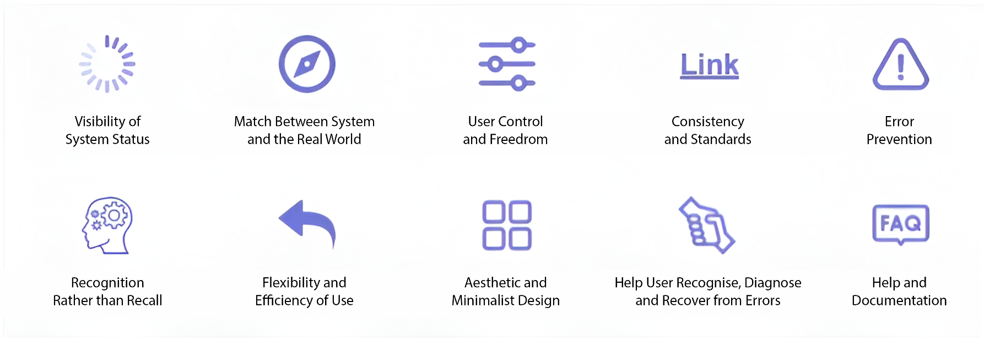
UX PRINCIPLES
Describe the most relevant HCI rules

Slide 14
HCI
Summarise the most relevant usability rules and how they apply to your project (duplicate slide)
- Visibility of System Status
User control & Freedom
Error Prevention
Flexibility & Efficiency of Use
Aesthetic & Minimalist Design
Error Recovery

Slide 15
RELEVANT CONVENTIONS
These could include:
Coding conventions – HTML, CSS (validated)
Coding conventions – Python (PEP8)
File Naming and file management
Web design conventions
Commenting
Usability Heuristics
Visual Hierarchy

Slide 16
RELEVANT CONVENTIONS
Discuss how you plan to apply relevant conventions to improve the quality of your outcome.

Slide 17
DESIGN : CONCEPT

Slide 18



LOGO DESIGN
SANCTA MARIA COLLEGE
COMPASS CAFÉ : CONCEPT
Initial VERSION
SIMPLIFIED
VER
I thought it would be better to simplify the logo because it will appear smaller – hence details are less prominent and has no point in being so detailed.

Slide 19
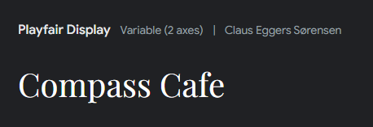
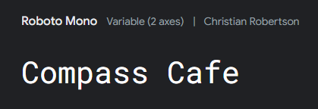
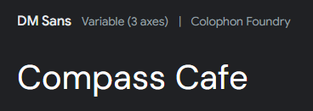
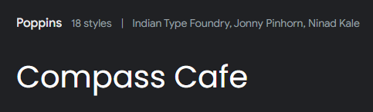
FONTS
WEBSITE DESIGN
GENERAL : CONCEPT
These fonts are easy to read, though my website is heavily on the site with graphic elements. However, It is best to find lettering that can easily help the admin find what they are looking for, such as in the admin dashboard. and bold lettering in navbar.

Slide 20
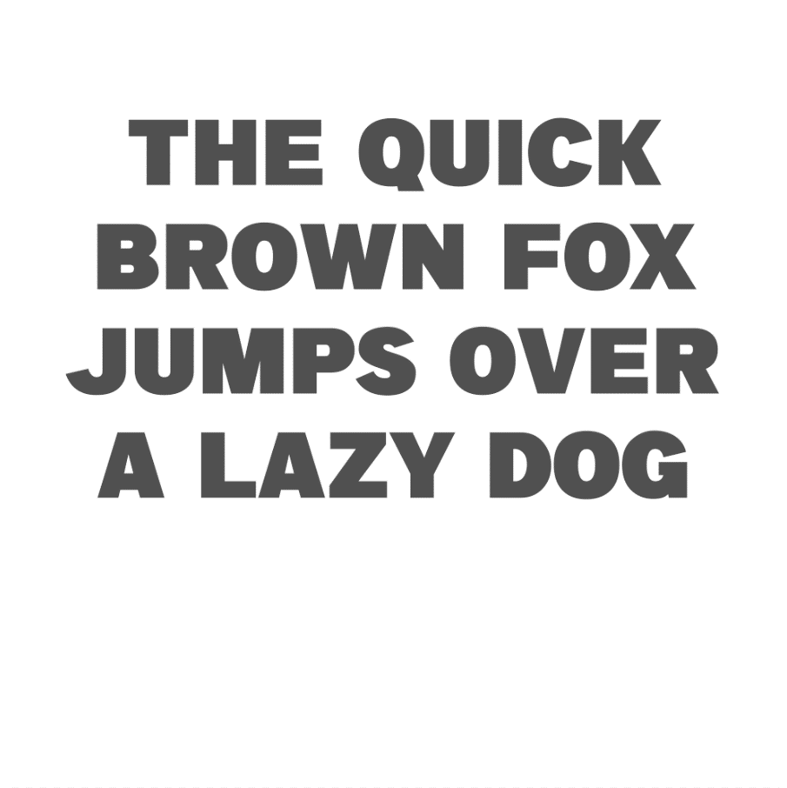
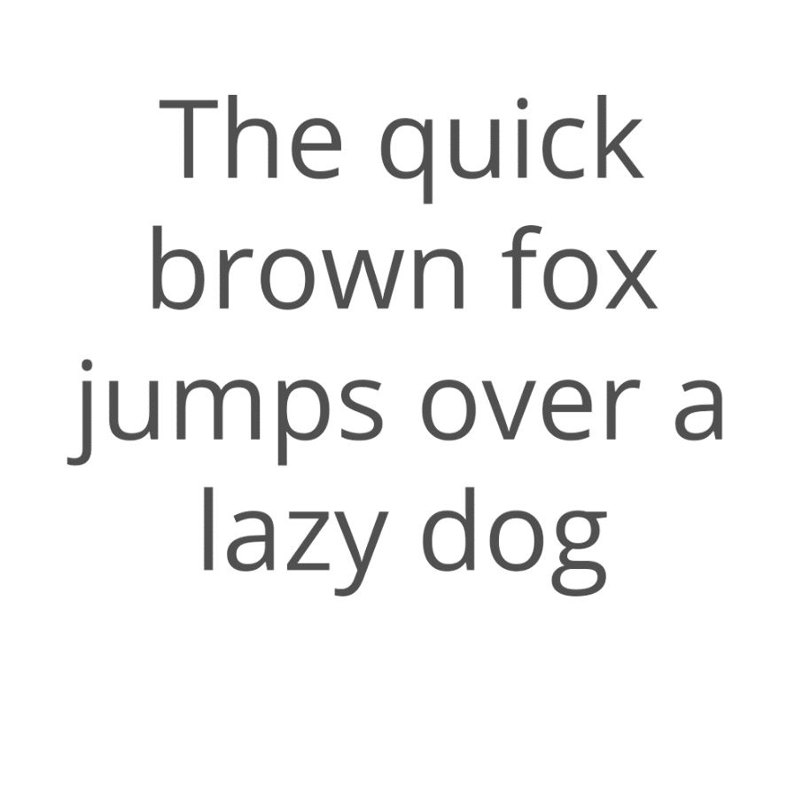
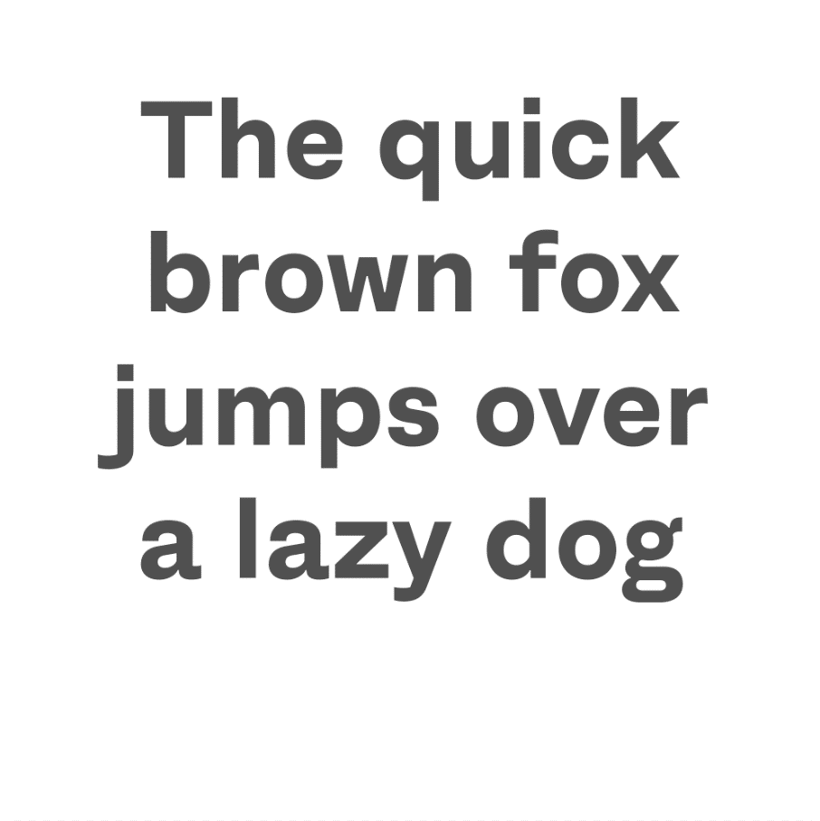
FONTS
WEBSITE DESIGN
GENERAL : REFINED
A Big Deal
Lato
Fracktif
Fit for a younger target audience: students at sancta maria college, would most likely be familiar with a modern look for a website than a sophisticated yet formal text (serif). Although serif is aesthetically pleasing and generally easier to read, branding would not suit as well with the cafeteria targeted towards a younger audience.

Slide 21
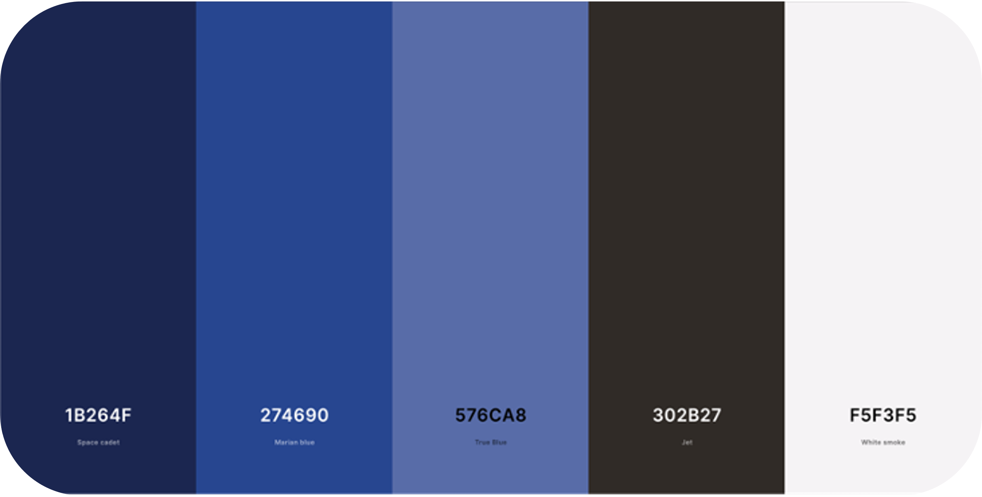
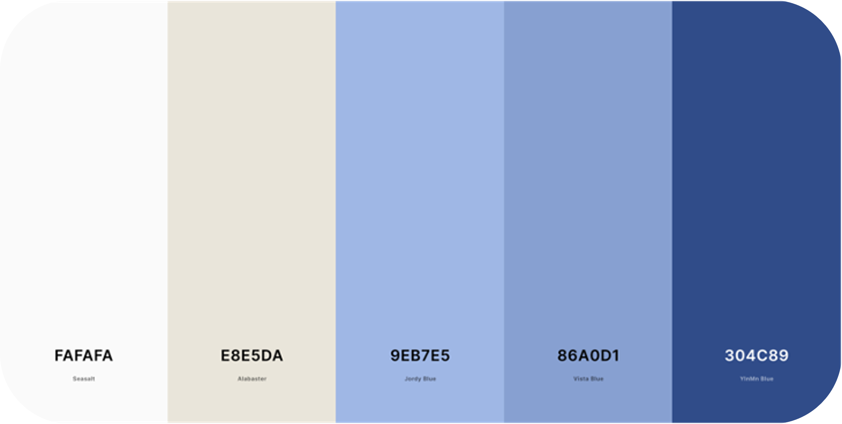
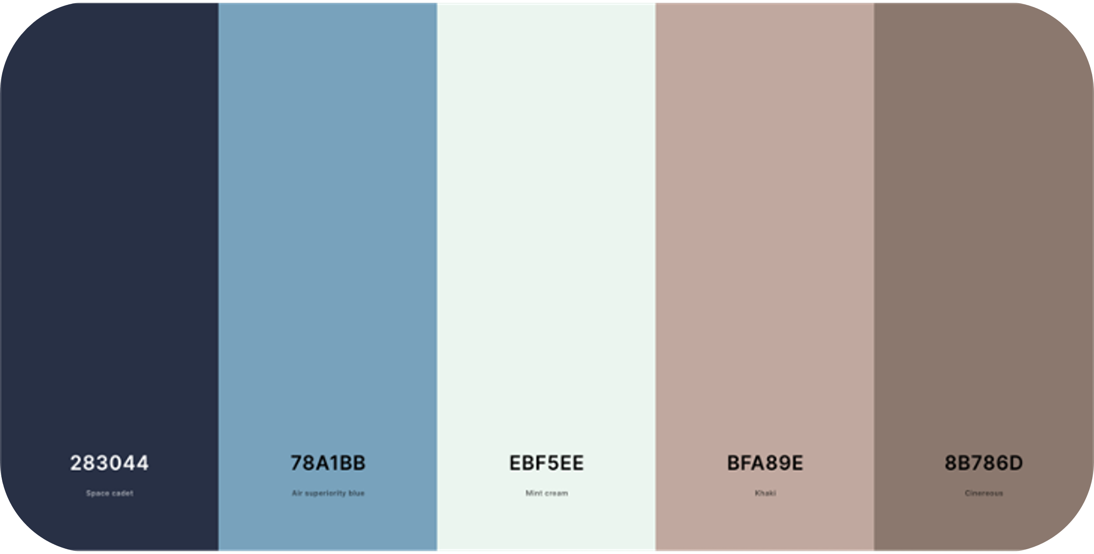
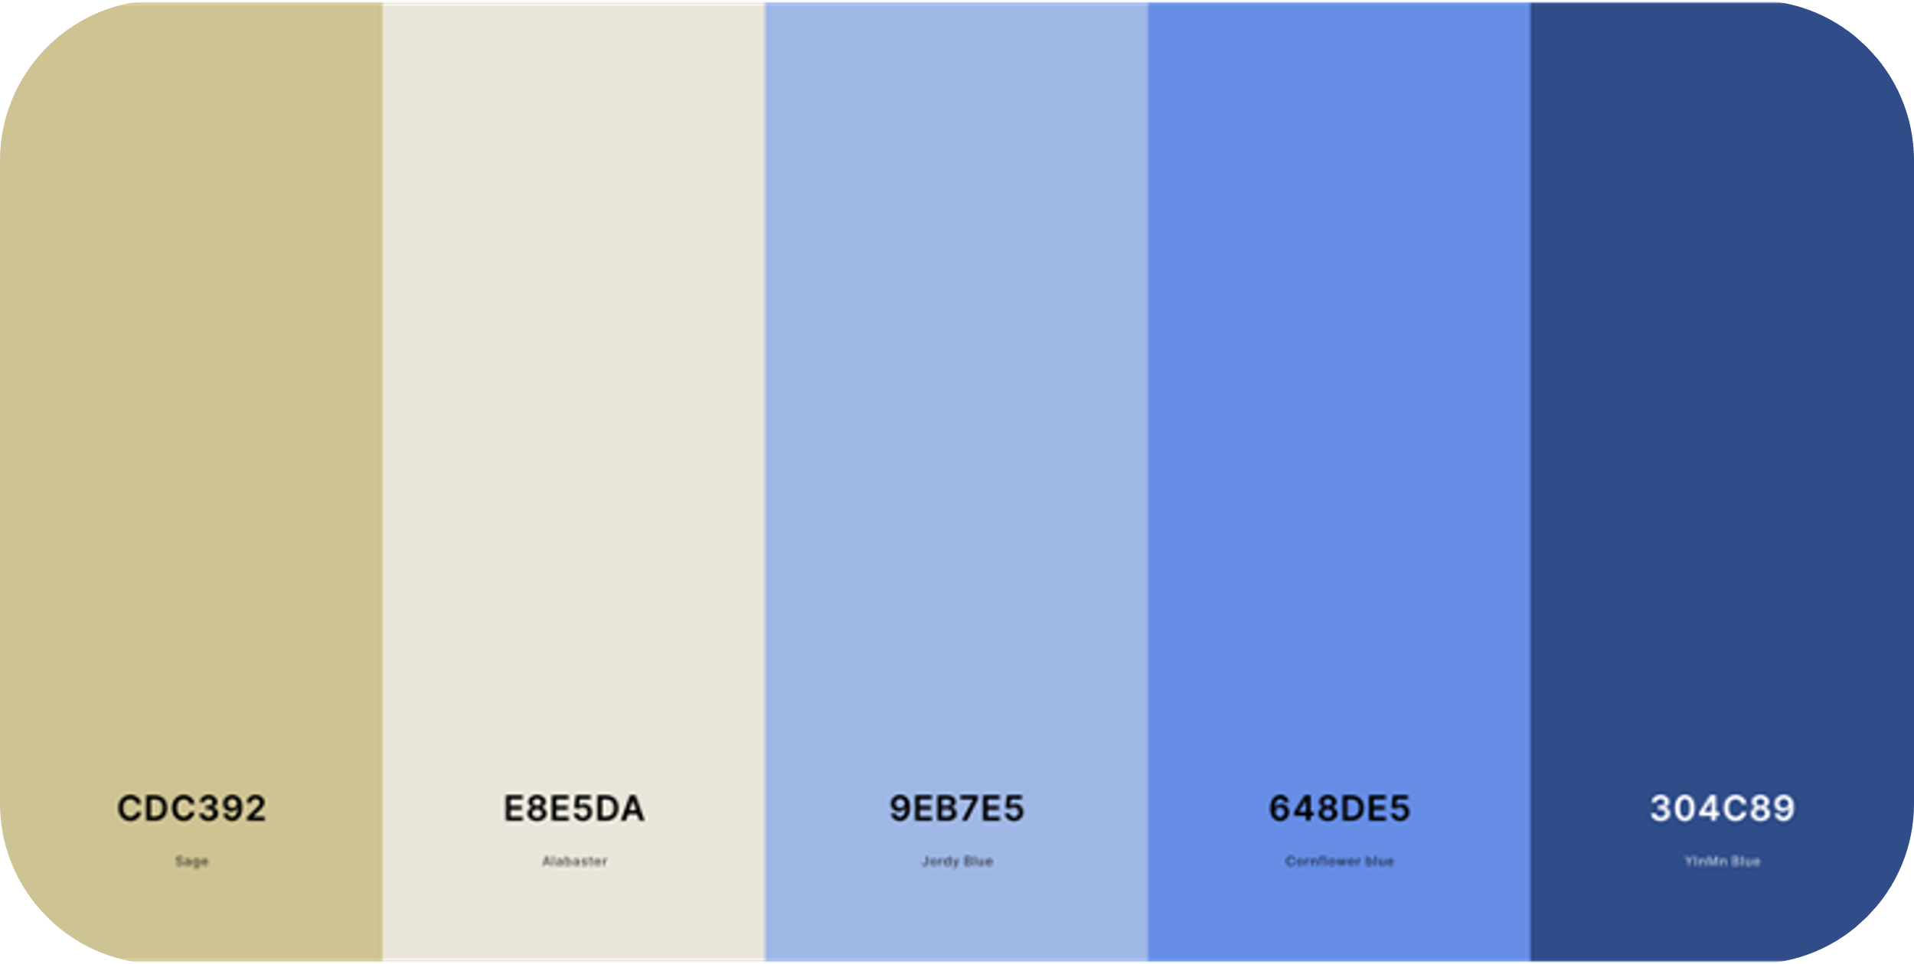
COLOUR PALETTE
WEBSITE DESIGN
GENERAL : CONCEPT

Slide 22
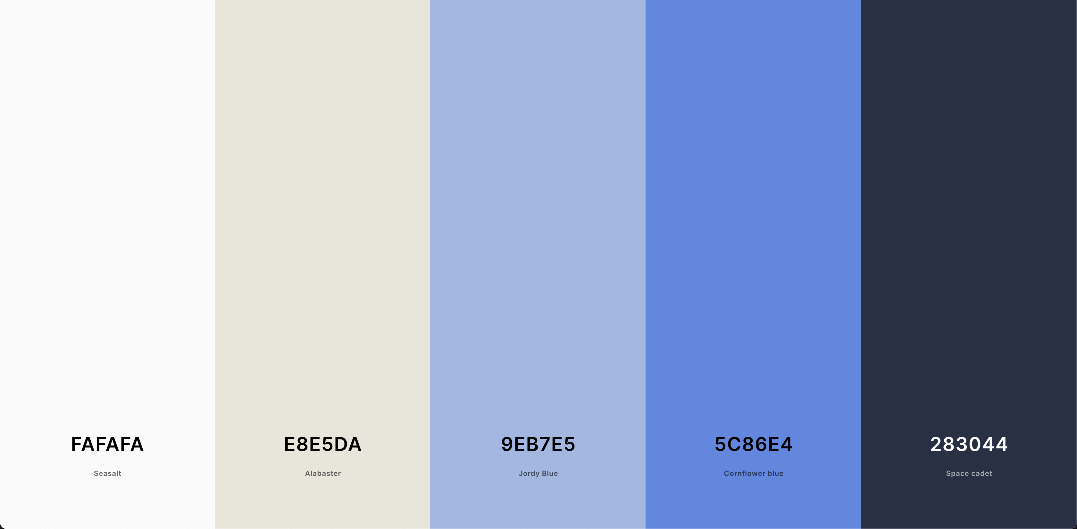
COLOUR PALETTE
WEBSITE DESIGN
GENERAL : REFINED

Slide 23







SITEMAP DESIGN
WEBSITE DESIGN
SITE MAP : BARE-BONES
HOME
NEWS
MENU
APPLY
CONTACT
ACCOUNT
SPECIAL DRINKS
BARISTA LUNCHTIME DUTY
SETTINGS
STAFF DRINKS
SCHEDULES
BALANCE
HOT BEVERAGES
SIGN IN /
REGISTER
COLD BEVERAGES
LOGOUT
[SIGNED IN]

Slide 24
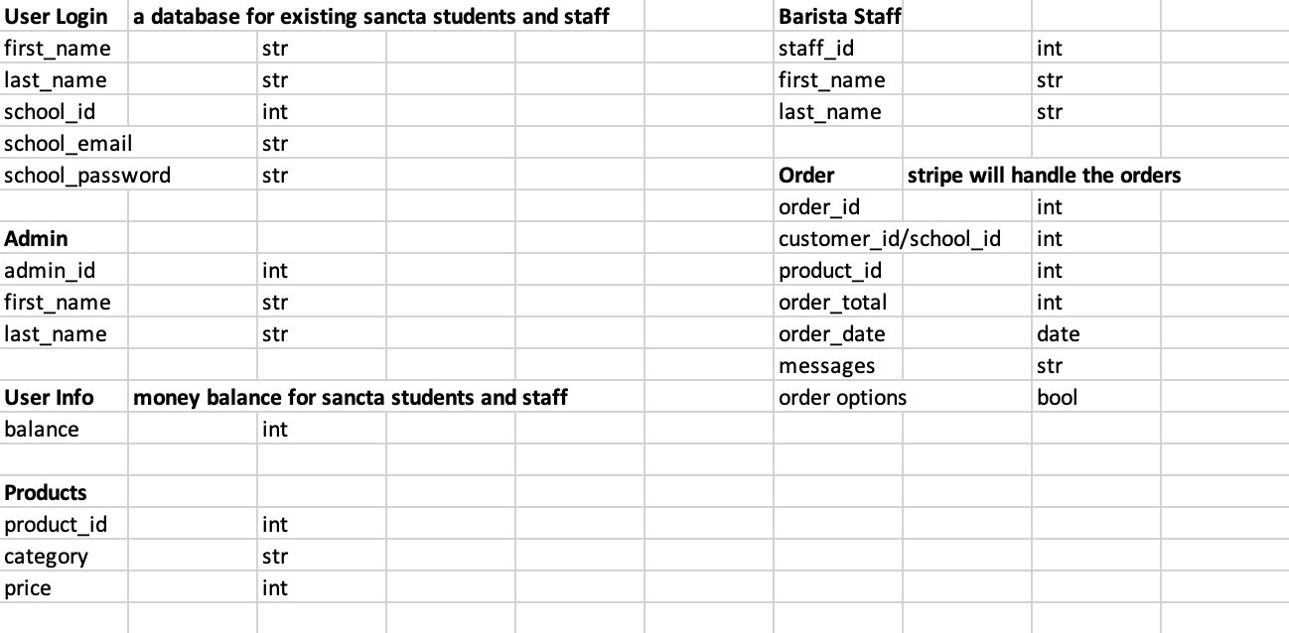



DATABASE DESIGN
WEBSITE DESIGN
DATABASE : BARE-BONES

Slide 25

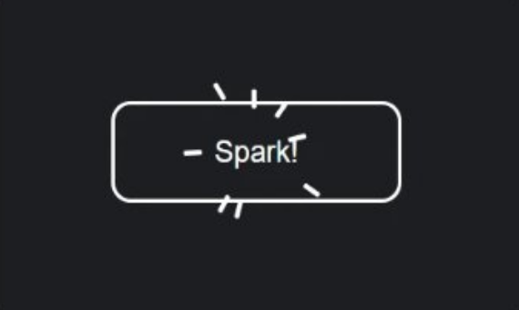
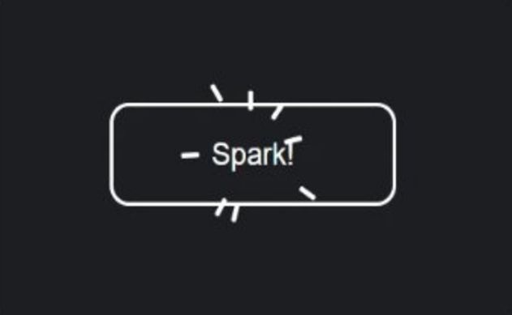
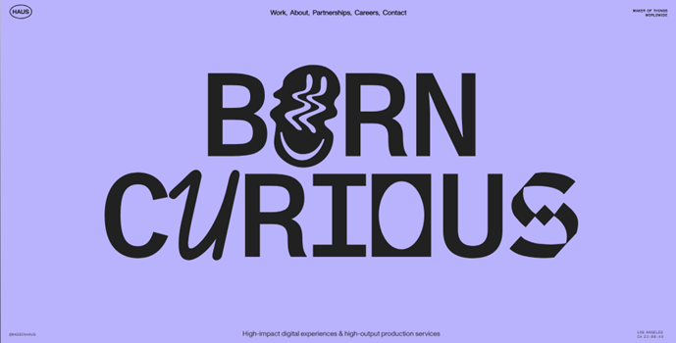
WEBSITE INSPIRATION
WEBSITE DESIGN
WEBPAGES : CONCEPT

Slide 26
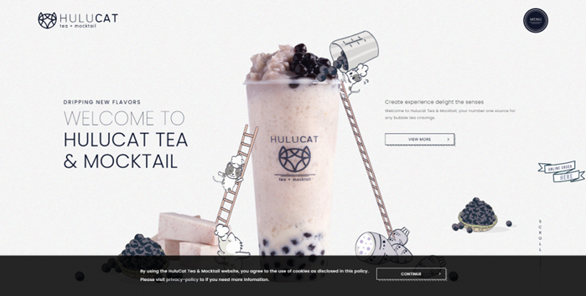
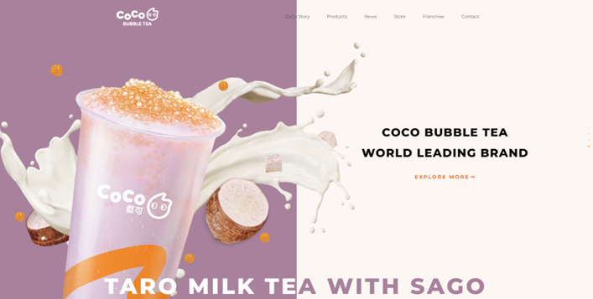
WEBSITE INSPIRATION
WEBSITE DESIGN
WEBPAGES : CONCEPT

Slide 27
DESIGN : TESTING
USER INTERFACE

Slide 28
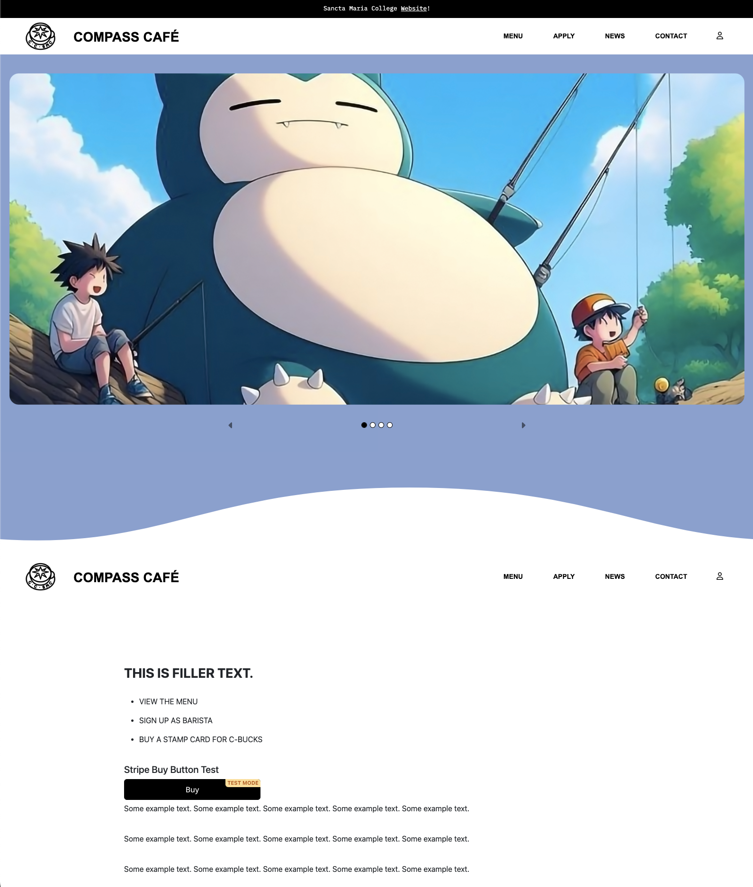
CONCEPTUAL DESIGN
WEBSITE DESIGN
WEBPAGES : DRAFT 01 – HOME
Colours look a bit too harsh or basic here, so it may not look as aesthetically pleasing to view, especially in dark mode.
Previously stated, the logo's initial design, although aesthetically pleasing, looks a bit too small to view all details, especially on smaller screens (phone).

Slide 29
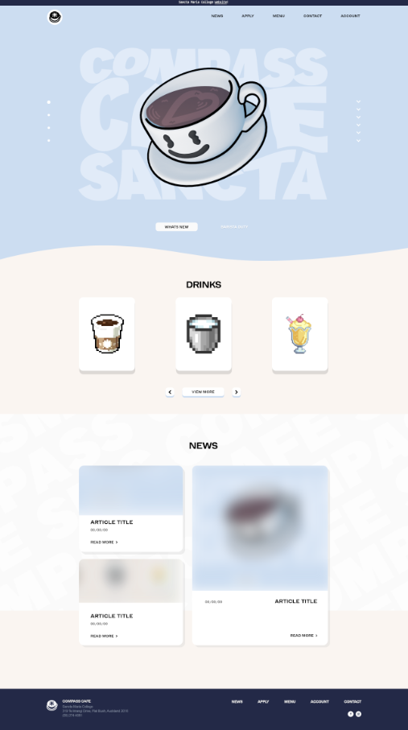
CONCEPTUAL DESIGN
WEBSITE DESIGN
WEBPAGES : DRAFT 02 – HOME
Newer colour palette because it seems like it blends in more and I like the pastel look. Hence a less harsh transition between colours.
Dark mode is popular and sometimes favourable with the current generation. There also comes health benefits with reducing eye strain especially at night. Hence, I may need to create a toggle button for dark mode.
[Layout is Subject to Change]

Slide 30
COLOUR PALETTE
WEBSITE DESIGN
GENERAL : FINAL

Slide 31
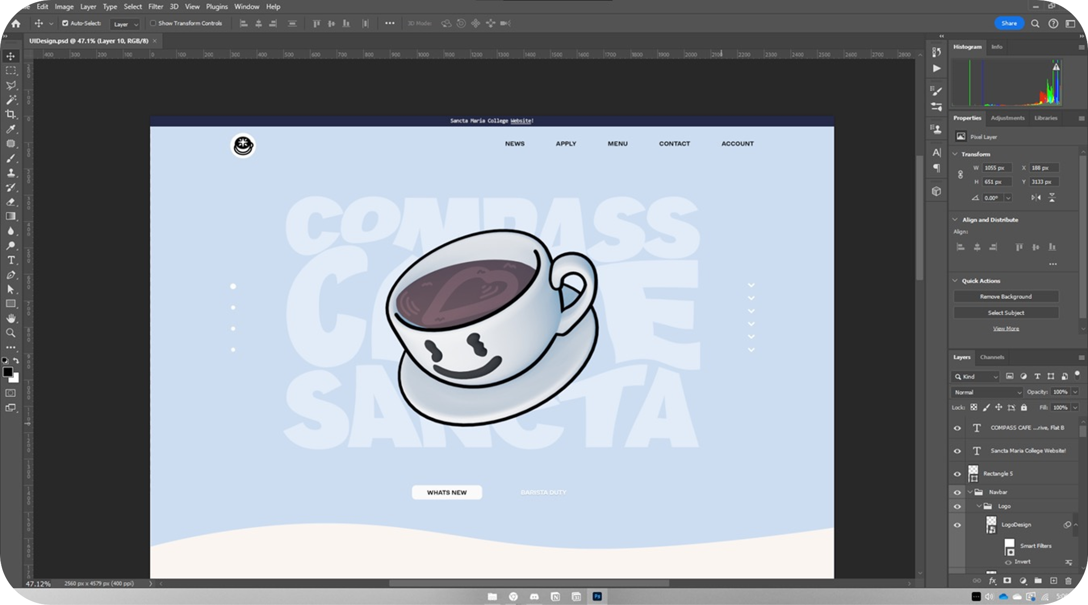
CONCEPTUAL DESIGN
WEBSITE DESIGN
WEBPAGES : CONCEPT – HOME
3D coffee following cursor in the hero section, which also functions as a carousel.

Slide 32
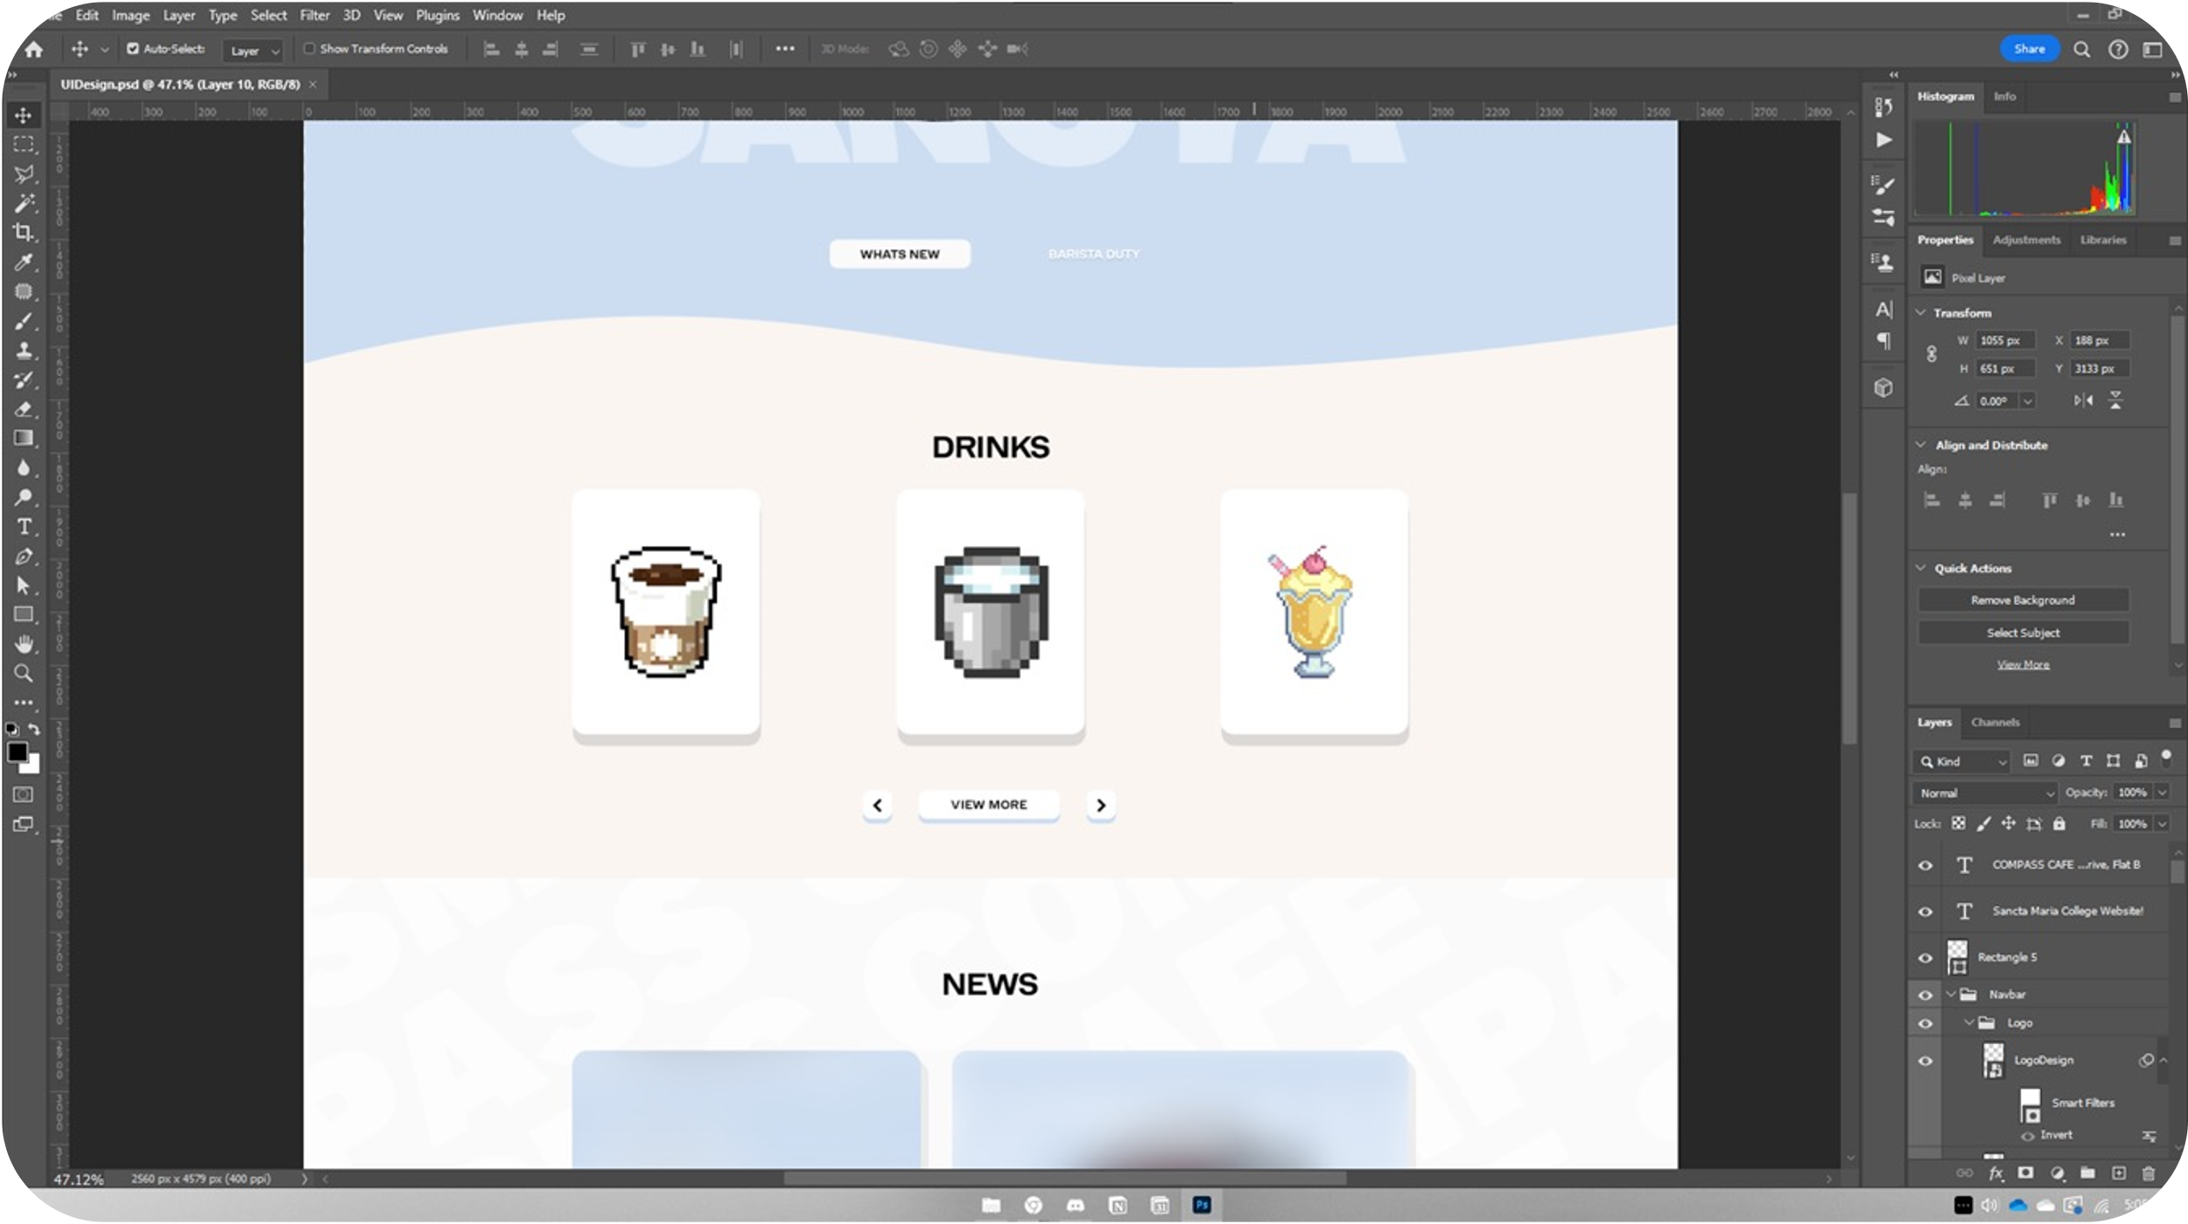
CONCEPTUAL DESIGN
WEBSITE DESIGN
WEBPAGES : CONCEPT – HOME
DESIGN 01
Menu section
Looks like a beach shore fr (school boat/water reference)
Improve description of selected drink
Too much blank space
[Subject to Change]

Slide 33
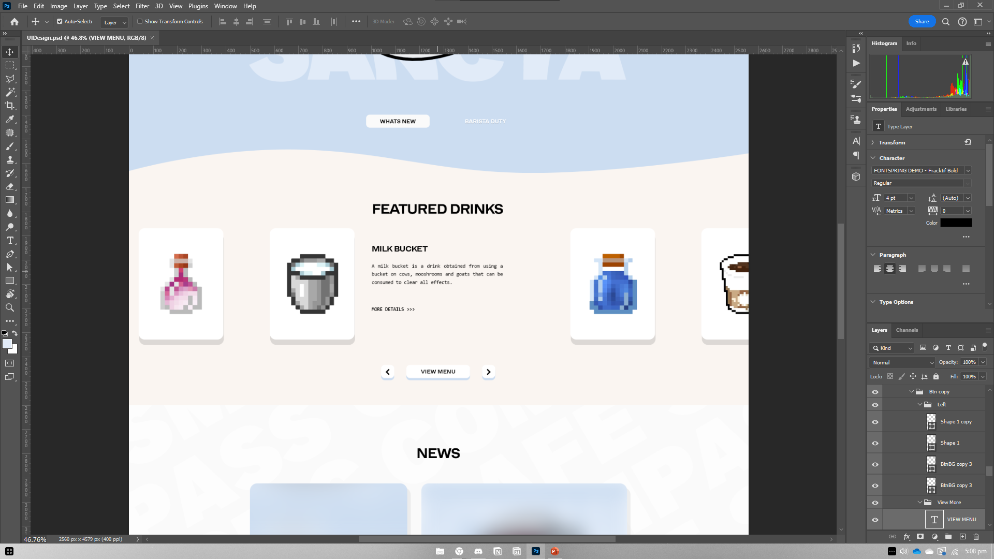
CONCEPTUAL DESIGN
WEBSITE DESIGN
WEBPAGES : CONCEPT – HOME
DESIGN 02
Probably a better design as a carousel and with a good balance between images and text.
I may have to fade in and out the text as each image card rotates like a carousel [HuluCat Reference]
[Subject to Change]

Slide 34
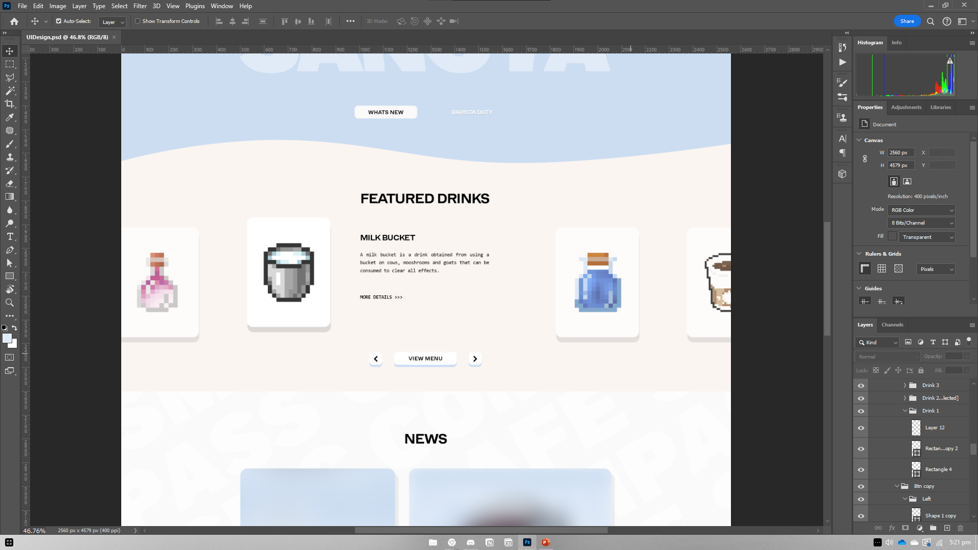
CONCEPTUAL DESIGN
WEBSITE DESIGN
WEBPAGES : CONCEPT – HOME
DESIGN 02.1
Making other cards lower and less opacity to put emphasis on the selected card.
[Subject to Change]

Slide 35
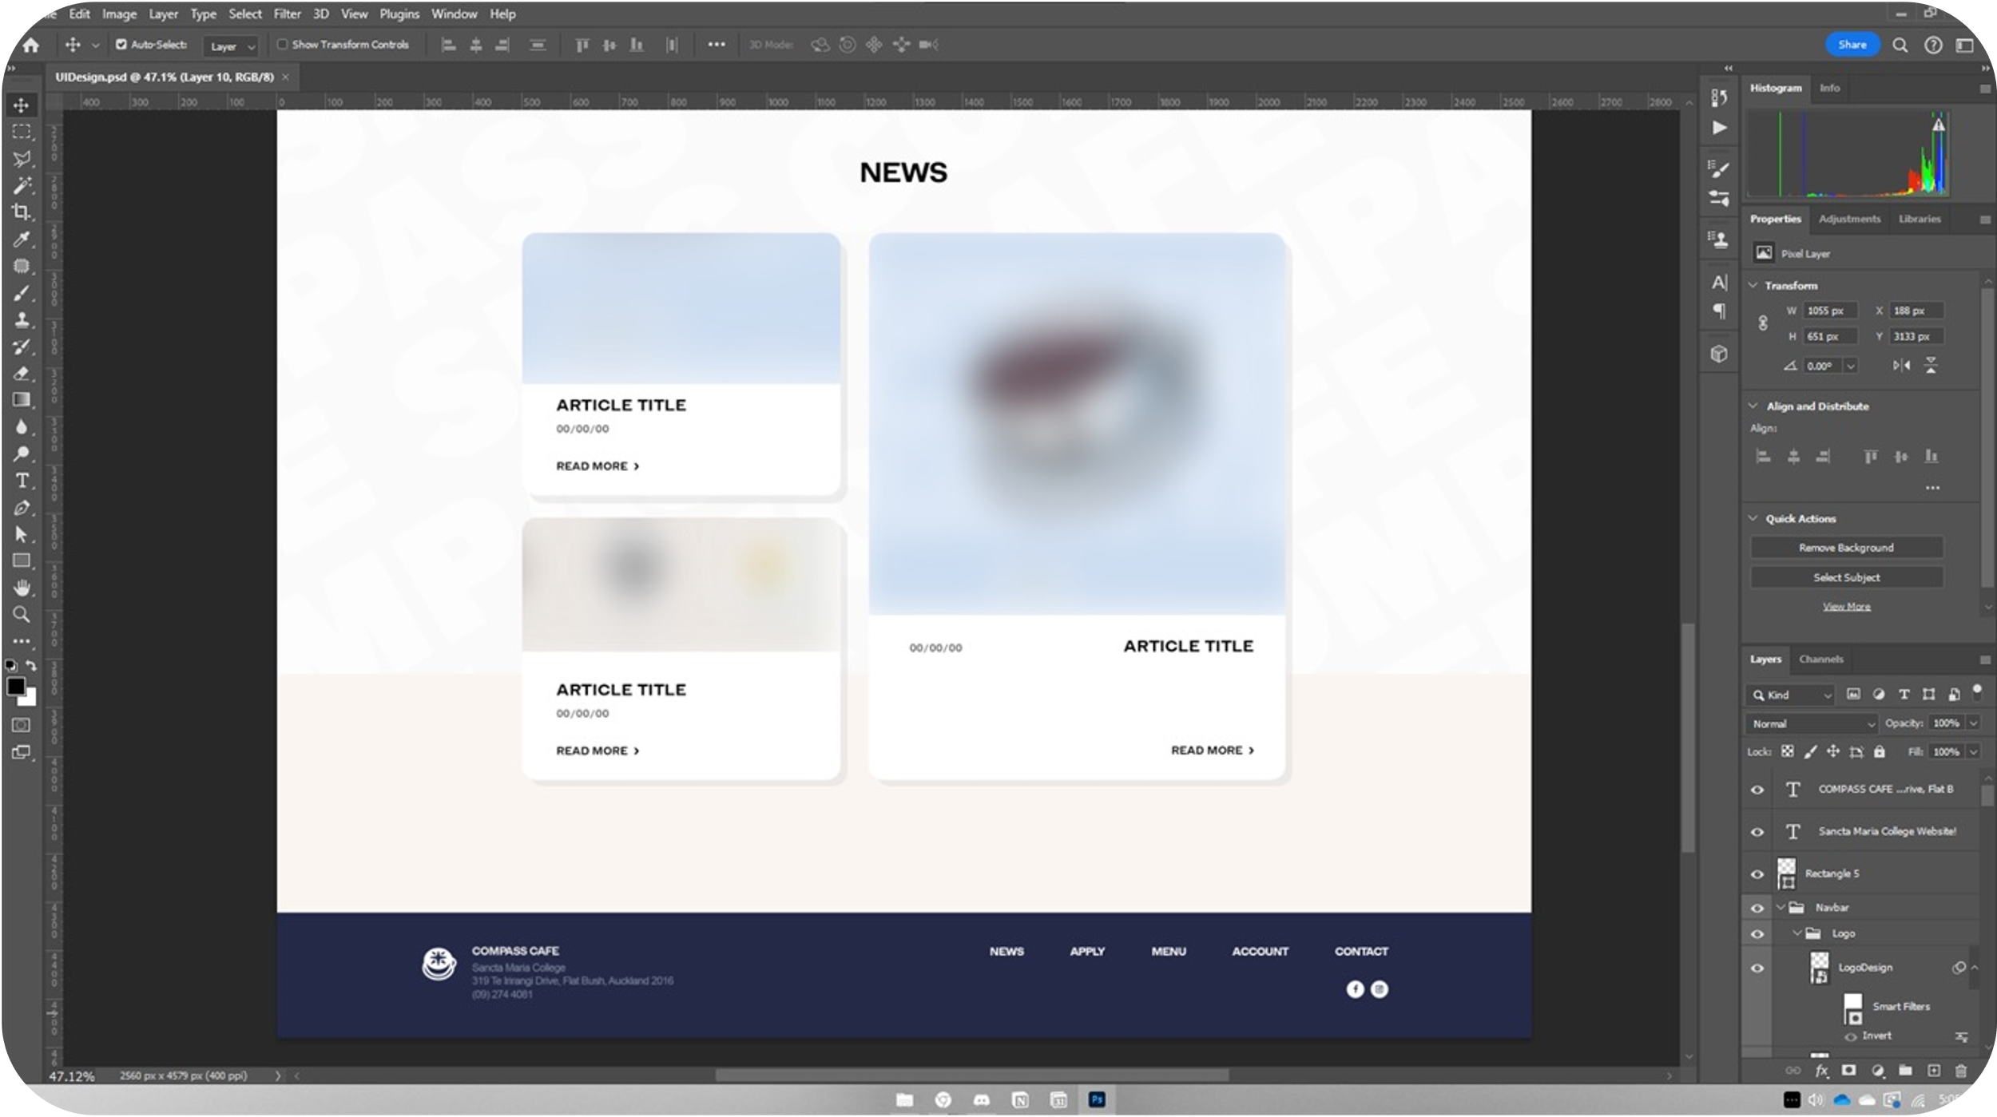
CONCEPTUAL DESIGN
WEBSITE DESIGN
WEBPAGES : CONCEPT – HOME
News Section [Could be a gallery section instead]
I like the tiles look per news article
Background could be improved
[Subject to Change]
Footer nice and simple

Slide 36
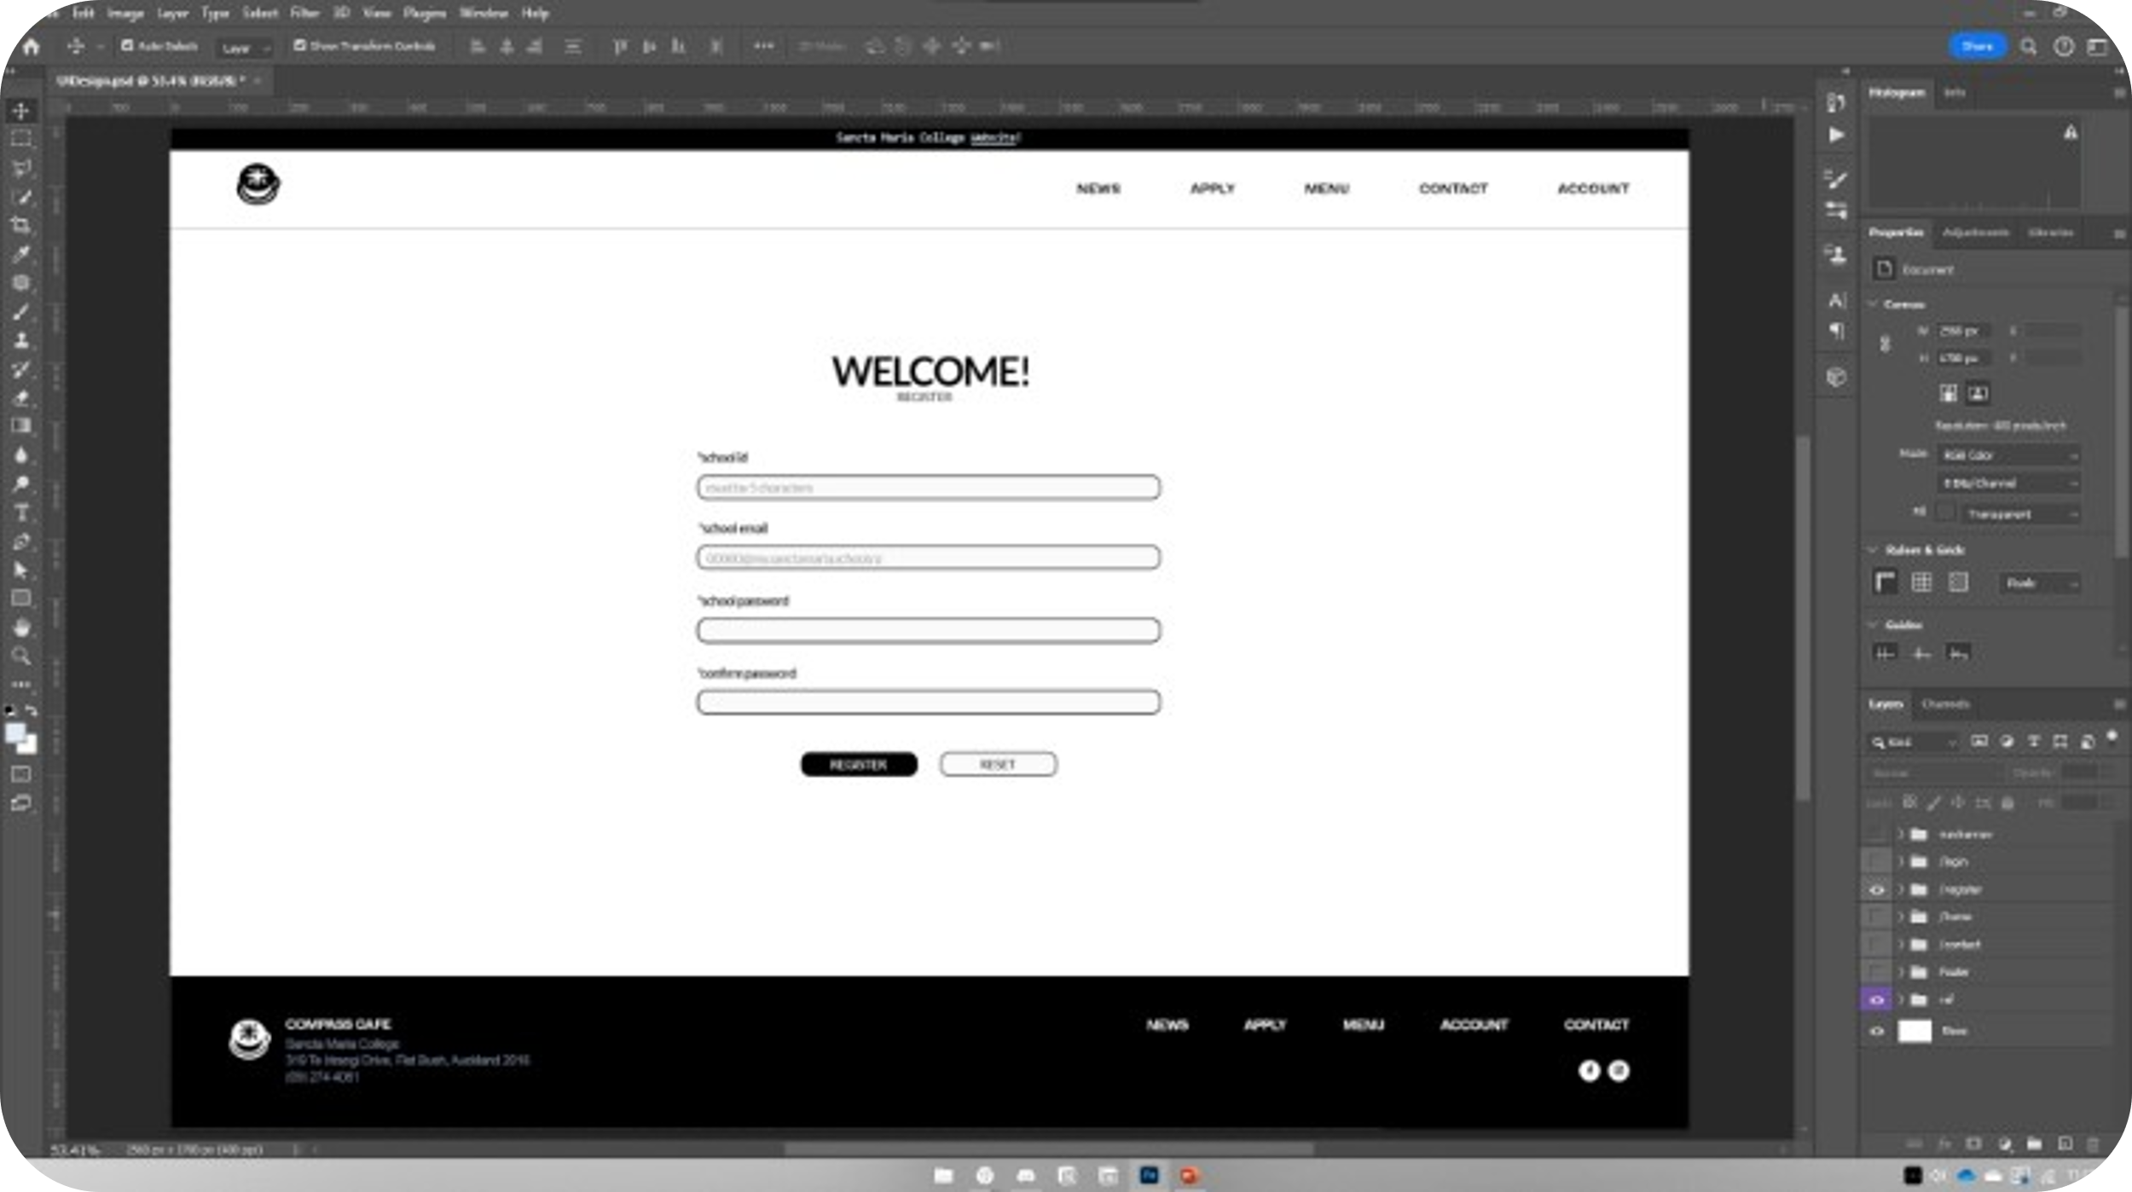
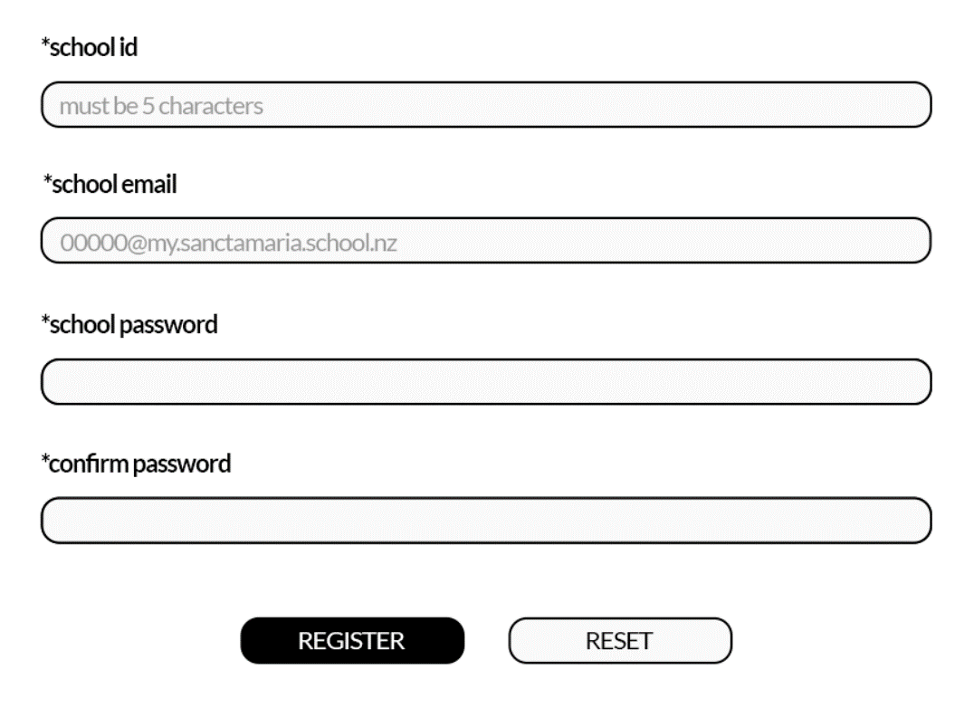
CONCEPTUAL DESIGN
WEBSITE DESIGN
WEBPAGES : WIREFRAME – REGISTER
Using id/school email as username
School password
[Subject to Change]

Slide 37
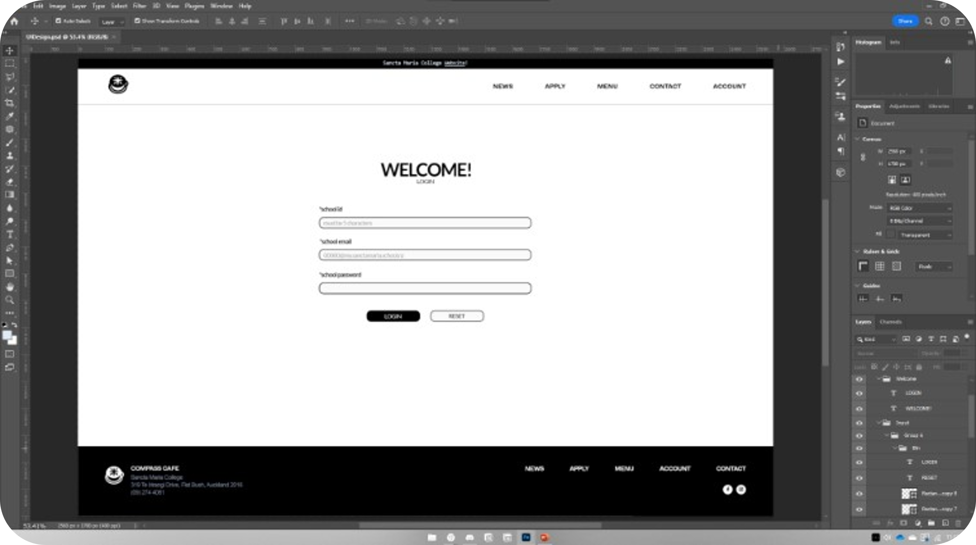
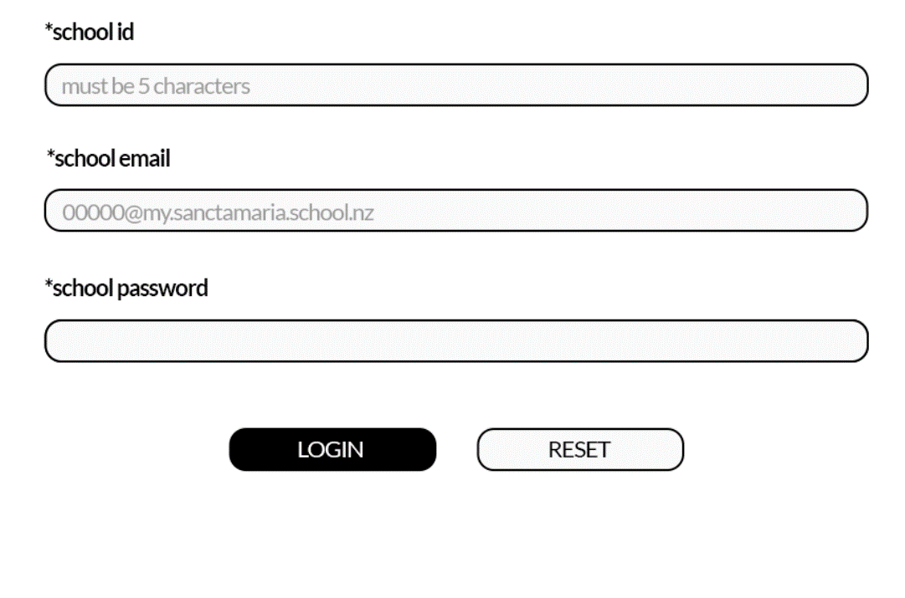
CONCEPTUAL DESIGN
WEBSITE DESIGN
WEBPAGES : WIREFRAME – LOGIN
Using id/school email as username
School password
[Subject to Change]

Slide 38
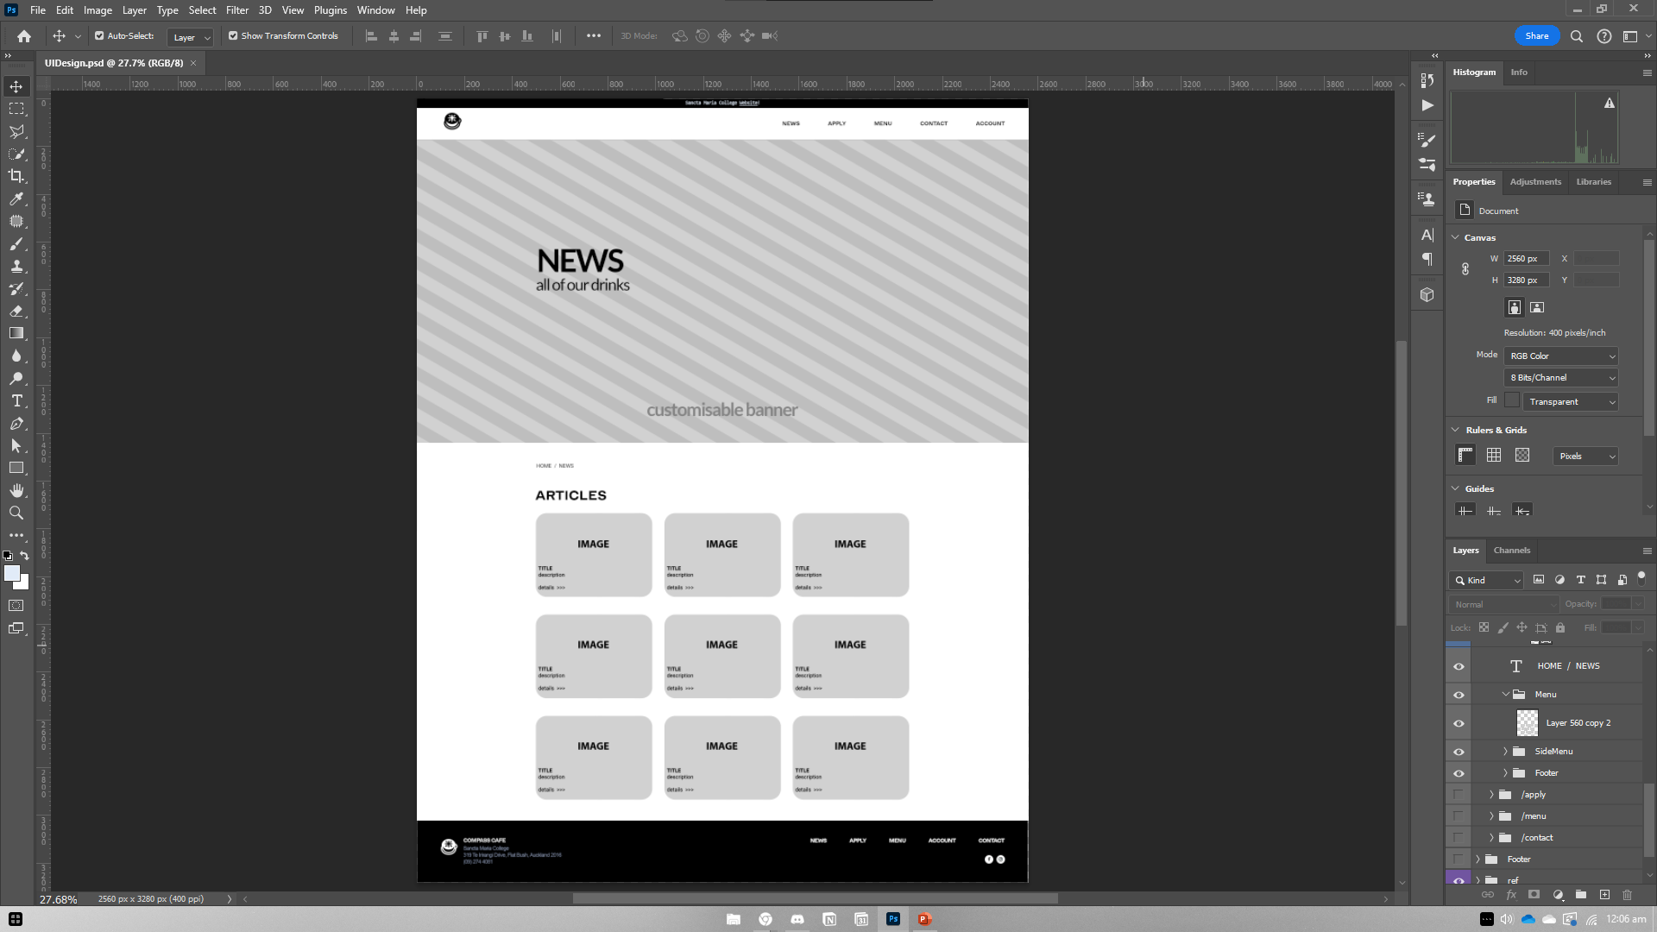
CONCEPTUAL DESIGN
WEBSITE DESIGN
WEBPAGES : WIREFRAME – NEWS
[OR GALLERY]
[Subject to Change]

Slide 39
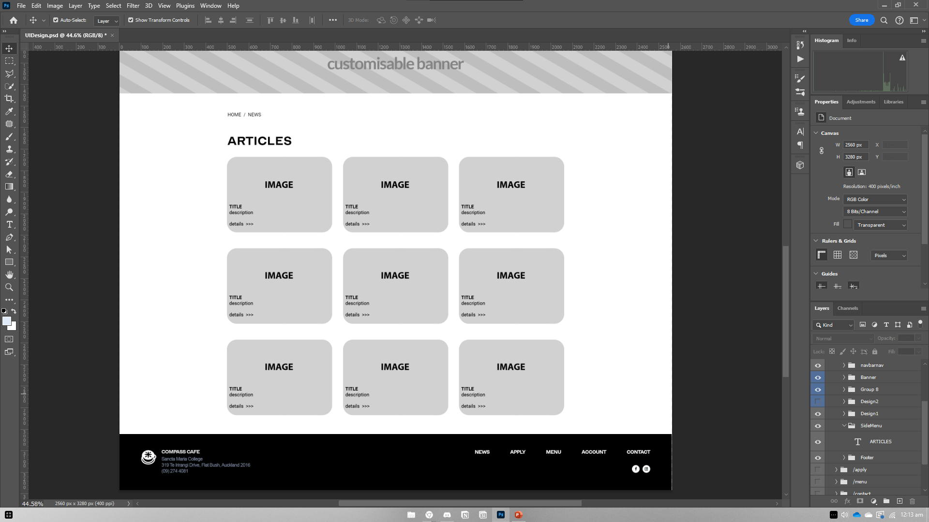
CONCEPTUAL DESIGN
WEBSITE DESIGN
WEBPAGES : WIREFRAME – NEWS
[OR GALLERY]
DESIGN 01
Could also be used as a gallery instead of news articles (or both).
[Subject to Change]

Slide 40
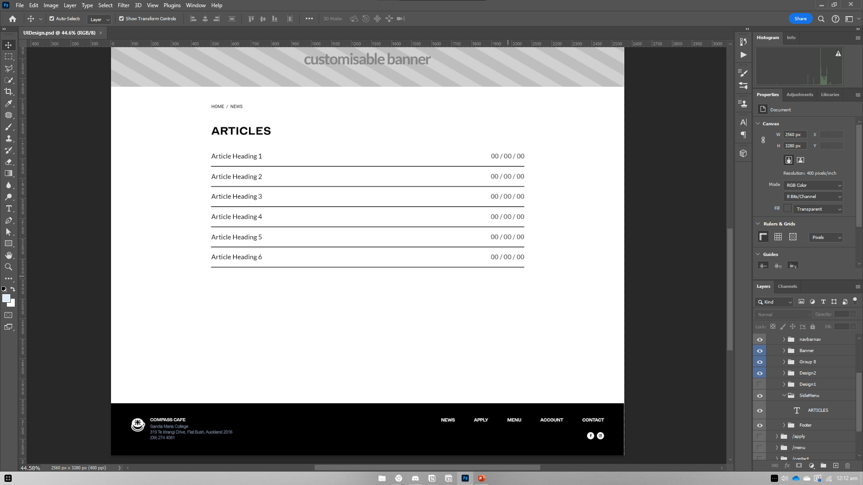
CONCEPTUAL DESIGN
WEBSITE DESIGN
WEBPAGES : WIREFRAME – NEWS
More compact approach.
[Subject to Change]

Slide 41
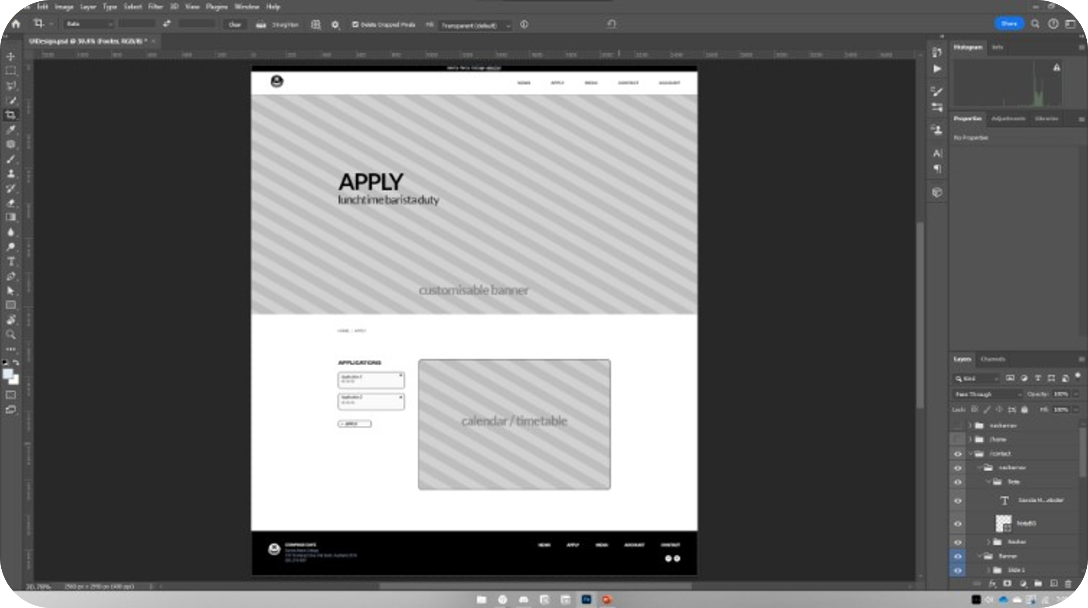
CONCEPTUAL DESIGN
WEBSITE DESIGN
WEBPAGES : WIREFRAME – APPLY
[Subject to Change]

Slide 42
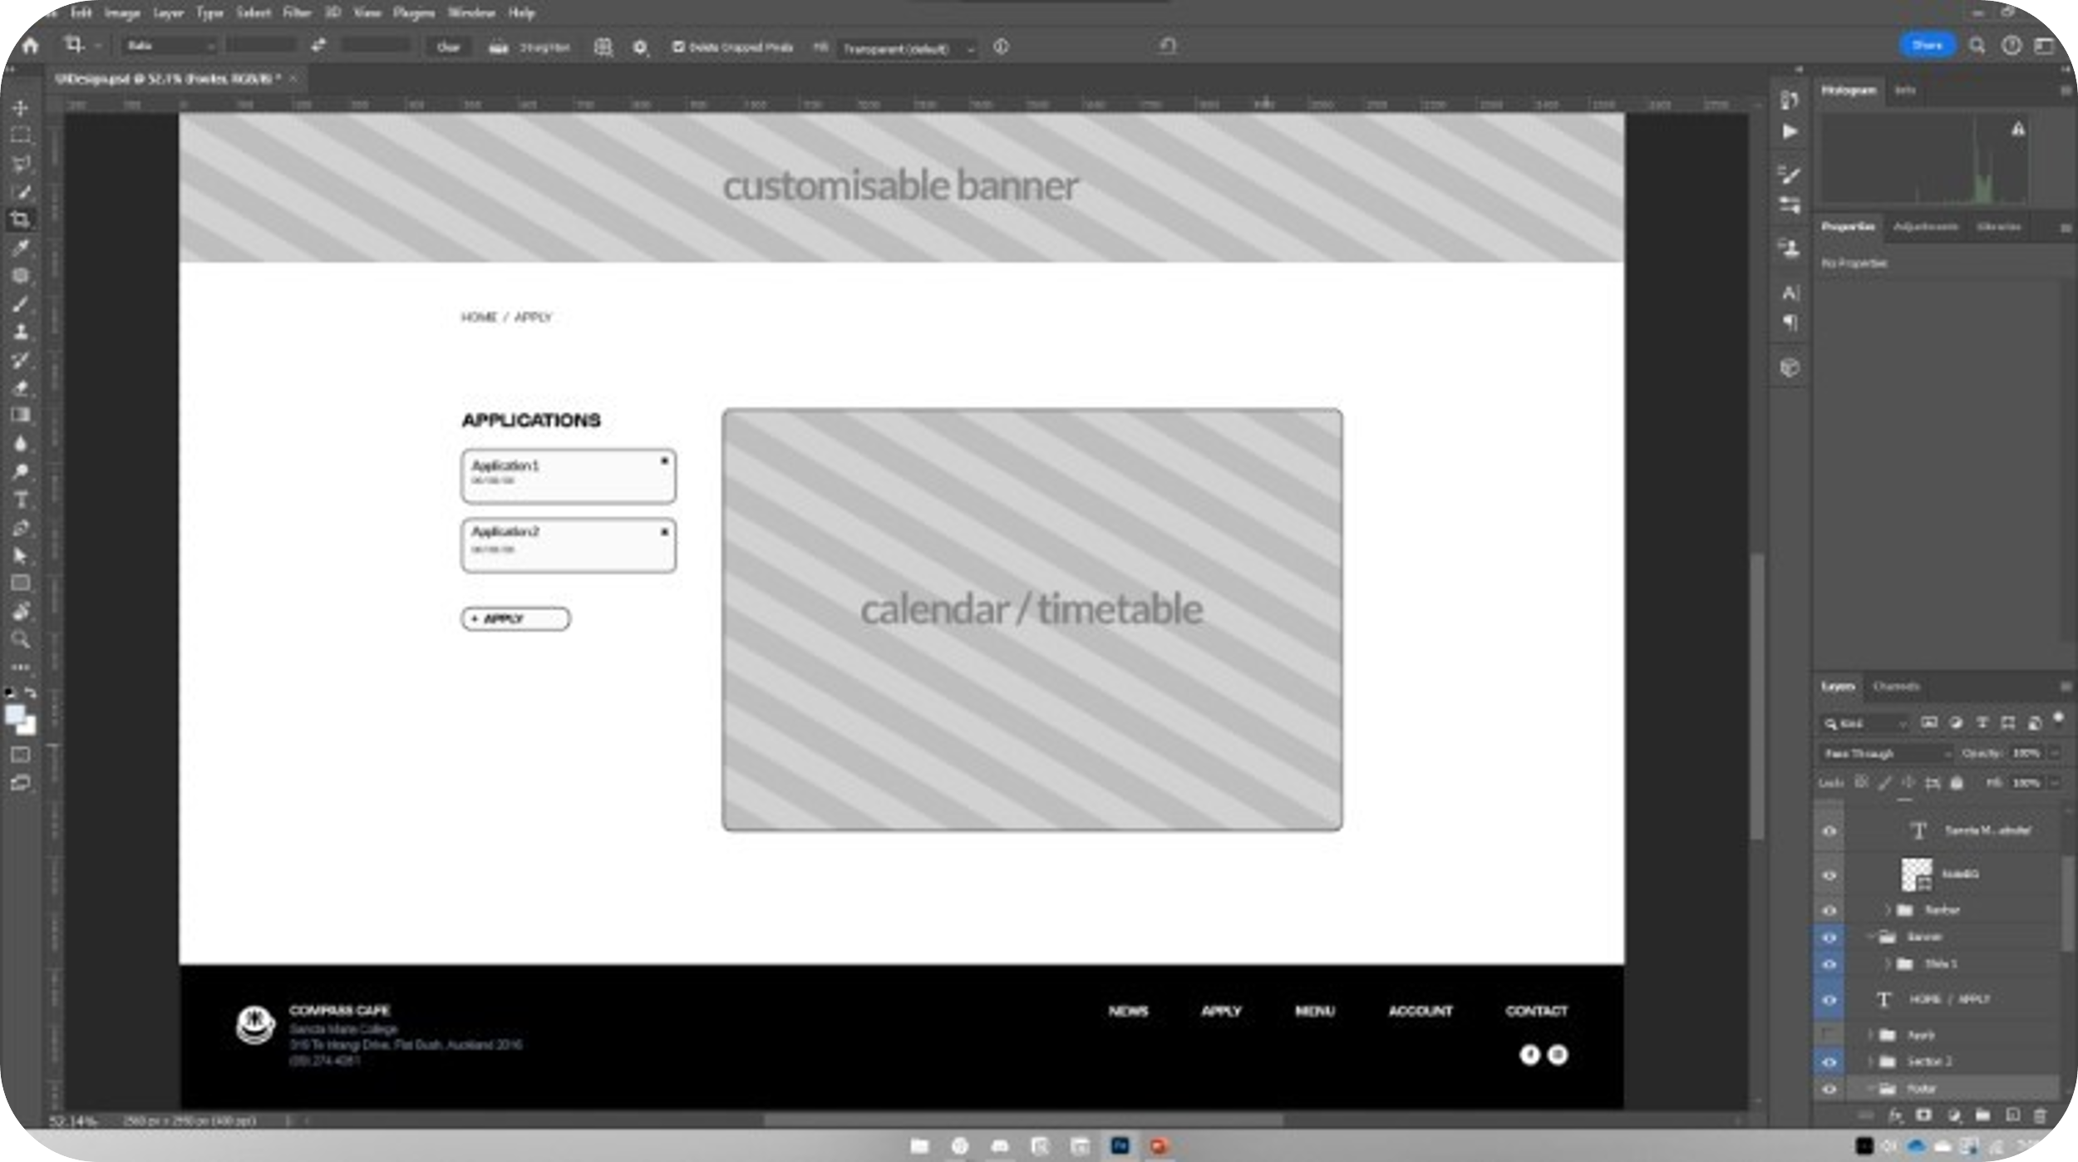
CONCEPTUAL DESIGN
WEBSITE DESIGN
WEBPAGES : WIREFRAME – APPLY
[Subject to Change]

Slide 43
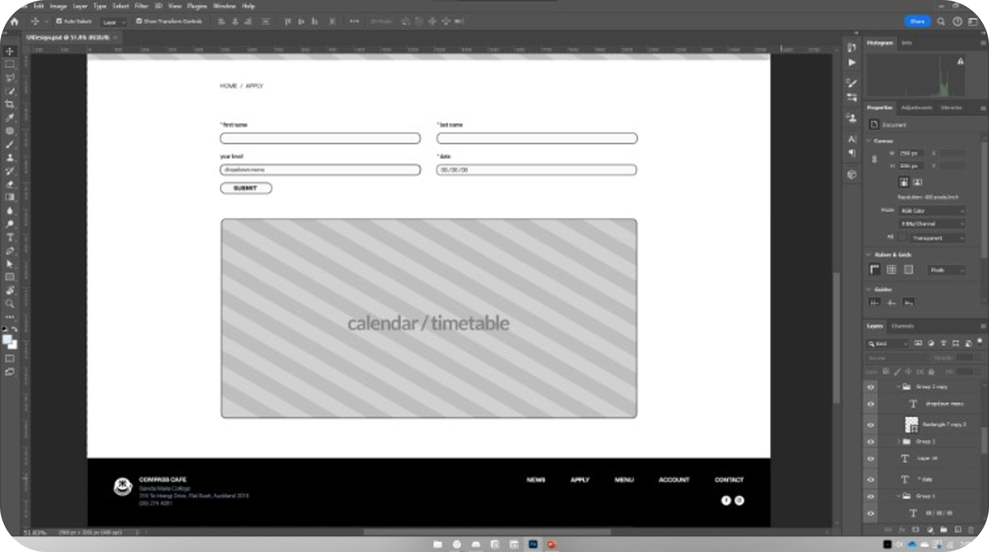
CONCEPTUAL DESIGN
WEBSITE DESIGN
WEBPAGES : WIREFRAME – APPLY
[Subject to Change]

Slide 44
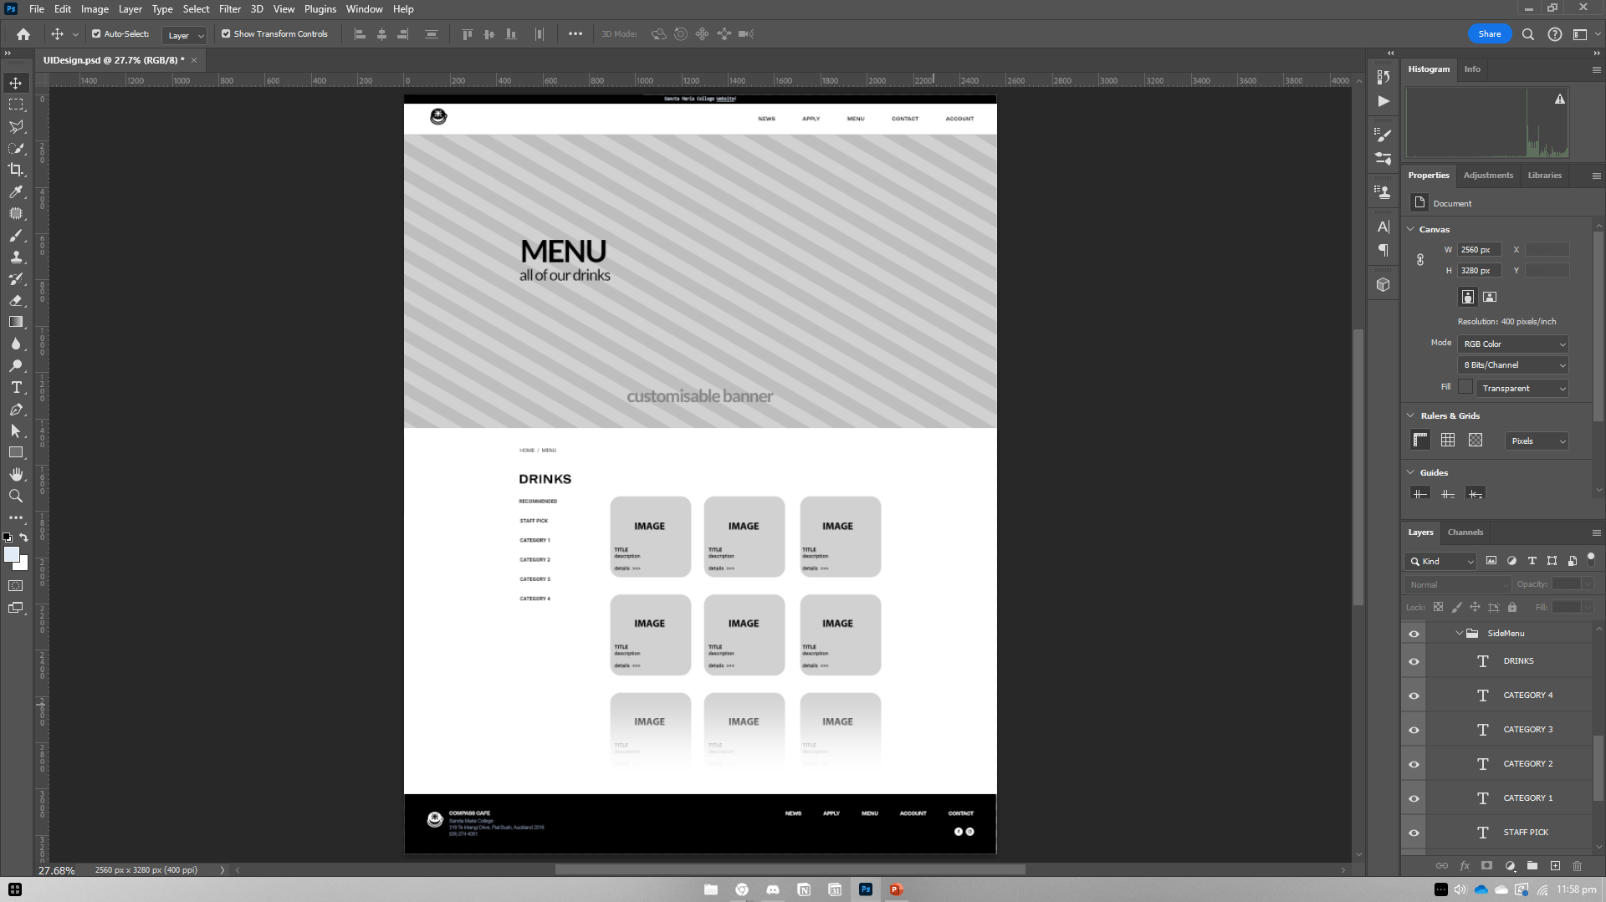
CONCEPTUAL DESIGN
WEBSITE DESIGN
WEBPAGES : WIREFRAME – MENU
[Subject to Change]

Slide 45
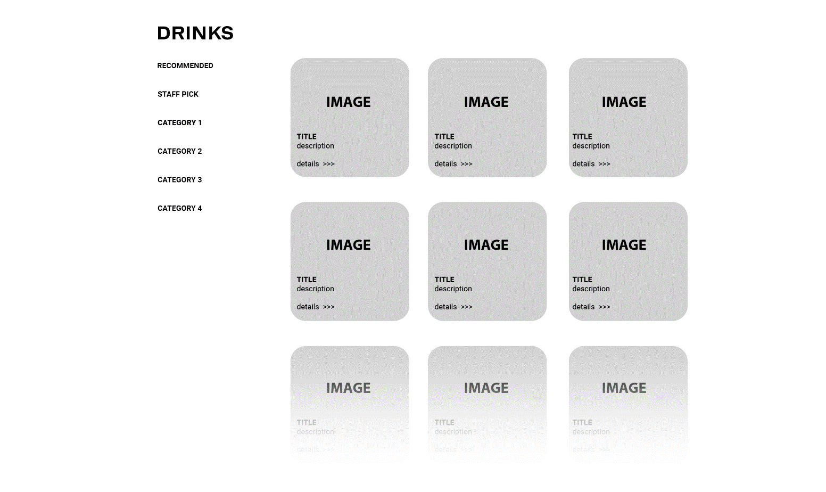
CONCEPTUAL DESIGN
WEBSITE DESIGN
WEBPAGES : WIREFRAME – MENU
[Subject to Change]

Slide 46
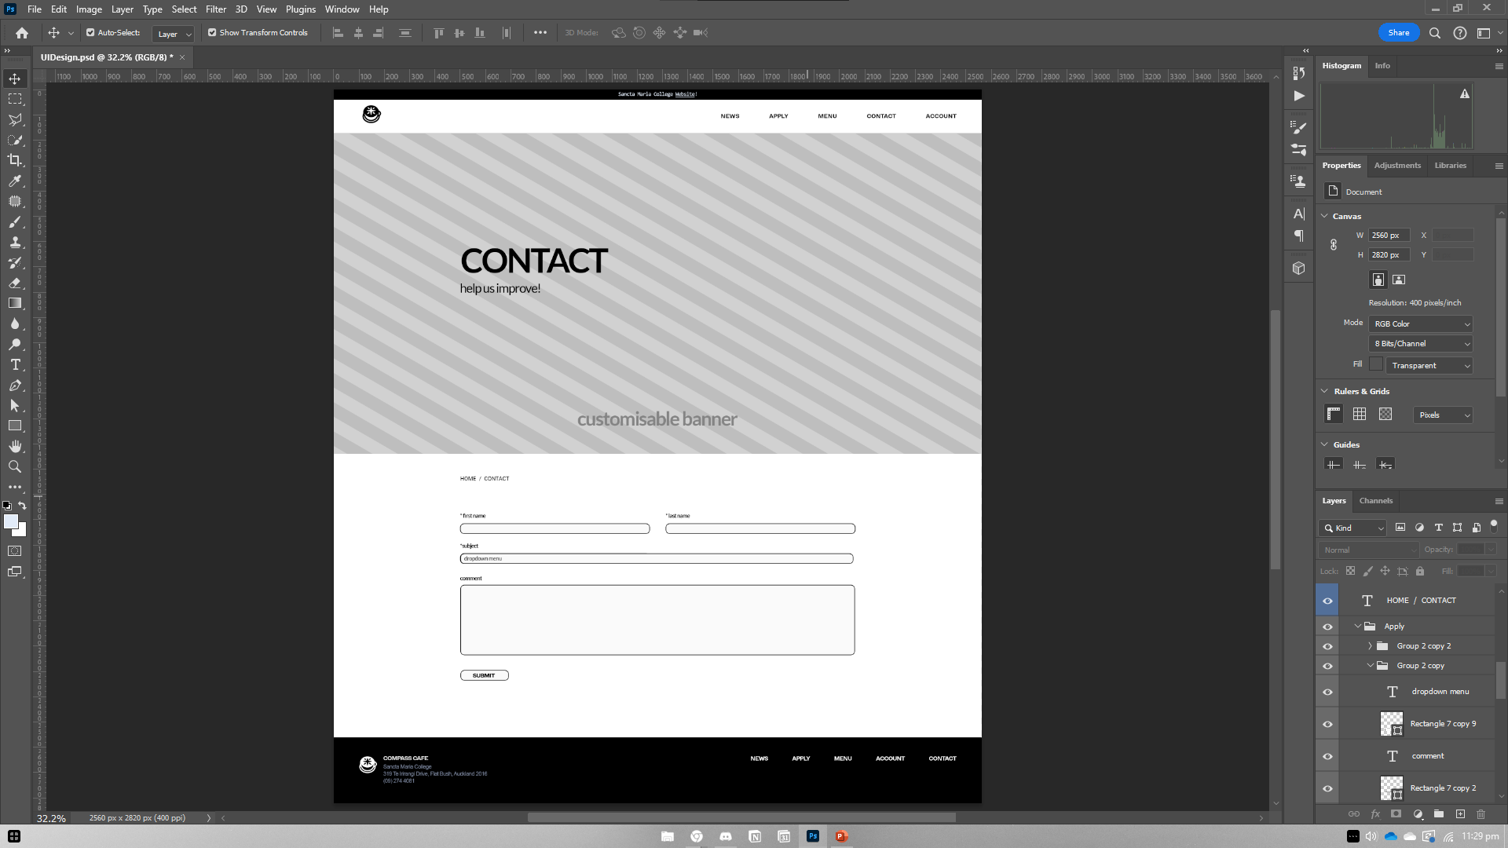
CONCEPTUAL DESIGN
WEBSITE DESIGN
WEBPAGES : WIREFRAME – CONTACT
Maybe keeping “help us improve!” lowercase comes as a friendlier approach compared to “HELP US IMPROVE!”, which sounds aggravating
[Subject to Change]

Slide 47
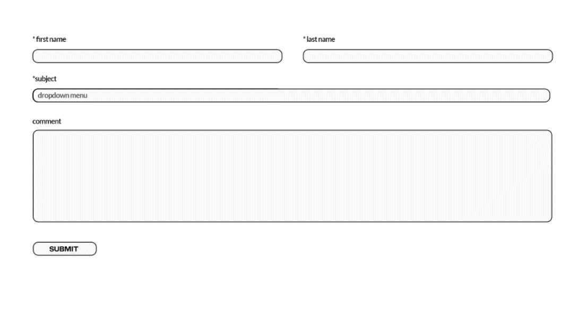
CONCEPTUAL DESIGN
WEBSITE DESIGN
WEBPAGES : WIREFRAME – CONTACT
Could possible add a change to contact email
FAQ Section
- Ask on the website
[Subject to Change]
On this note, I will have to ask my client if there is anything to be answered.
FAQ may only appear when sufficient questions have been answered regarding the cafeteria.

Slide 48
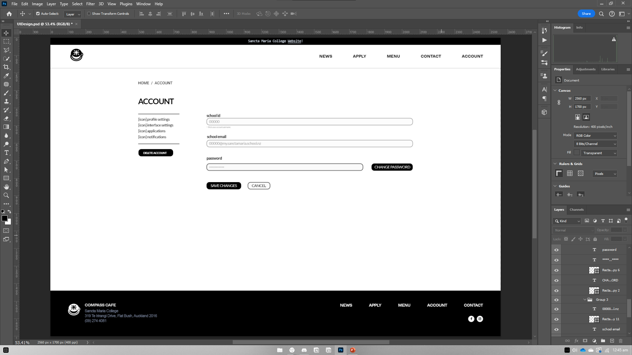
CONCEPTUAL DESIGN
WEBSITE DESIGN
WEBPAGES : WIREFRAME – ACCOUNT
[Subject to Change]

Slide 49
DISCUSSION
WEBSITE DESIGN
WEBPAGES : THOUGHTS
I could go in depth in designing the template interface for the news article, though it may be unnecessary to do so with each drink on the menu.

Slide 50
DESIGN : TESTING
ADMIN INTERFACE

Slide 51
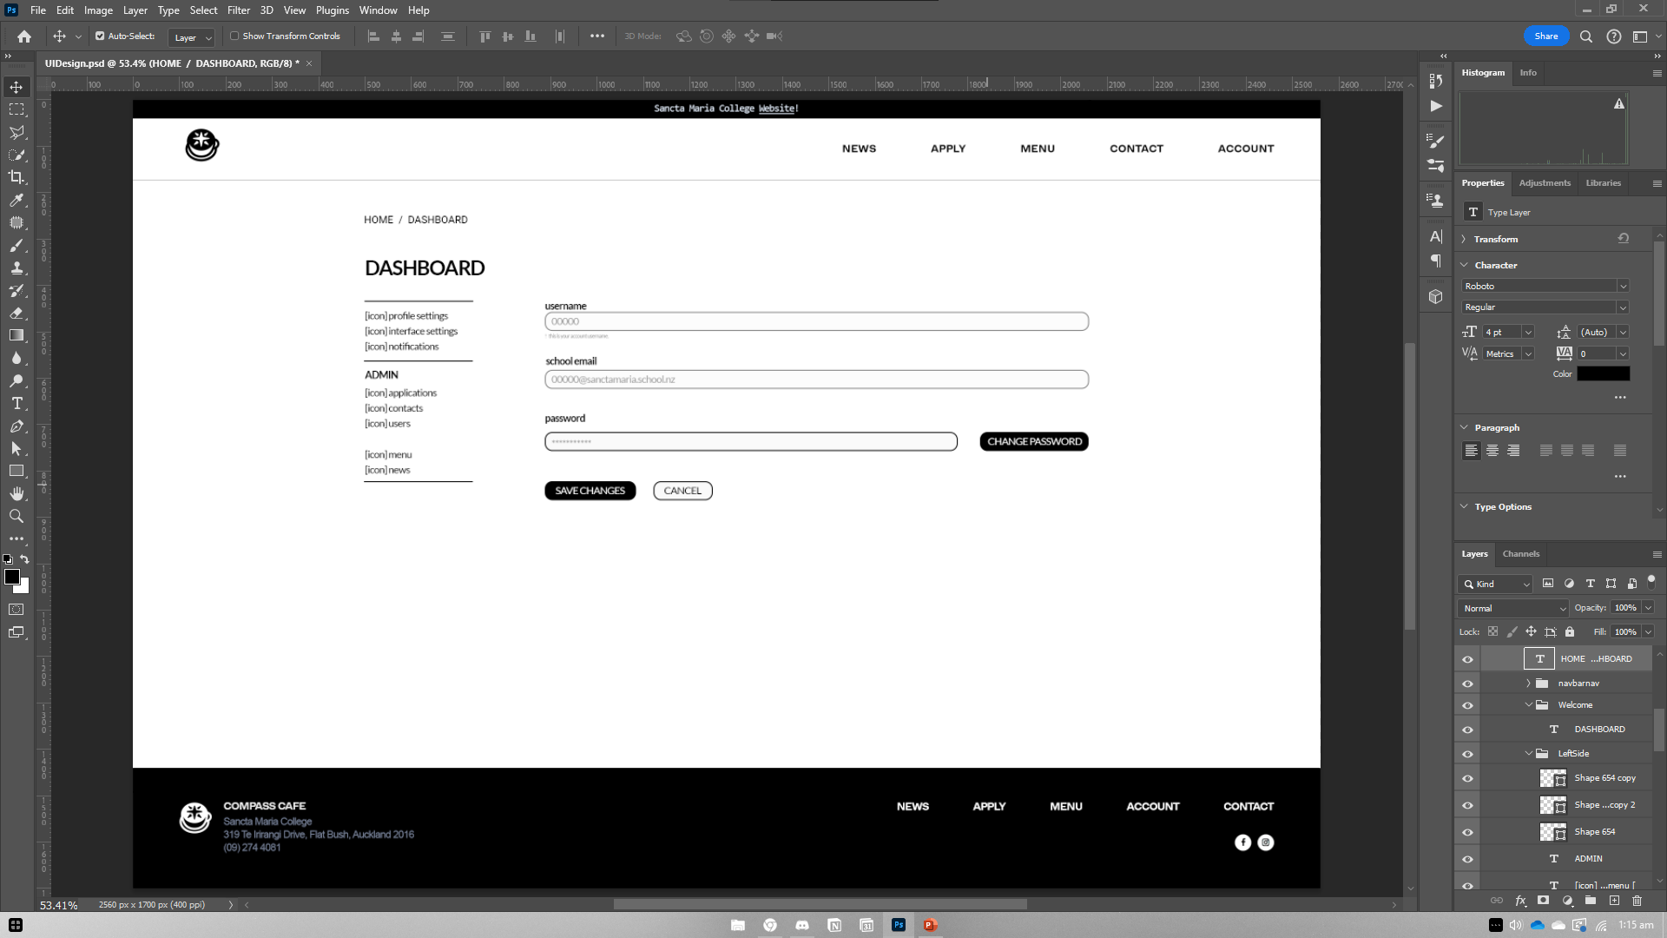
CONCEPTUAL DESIGN
WEBSITE DESIGN
WEBPAGES : WIREFRAME – DASHBOARD
[Subject to Change]

Slide 52
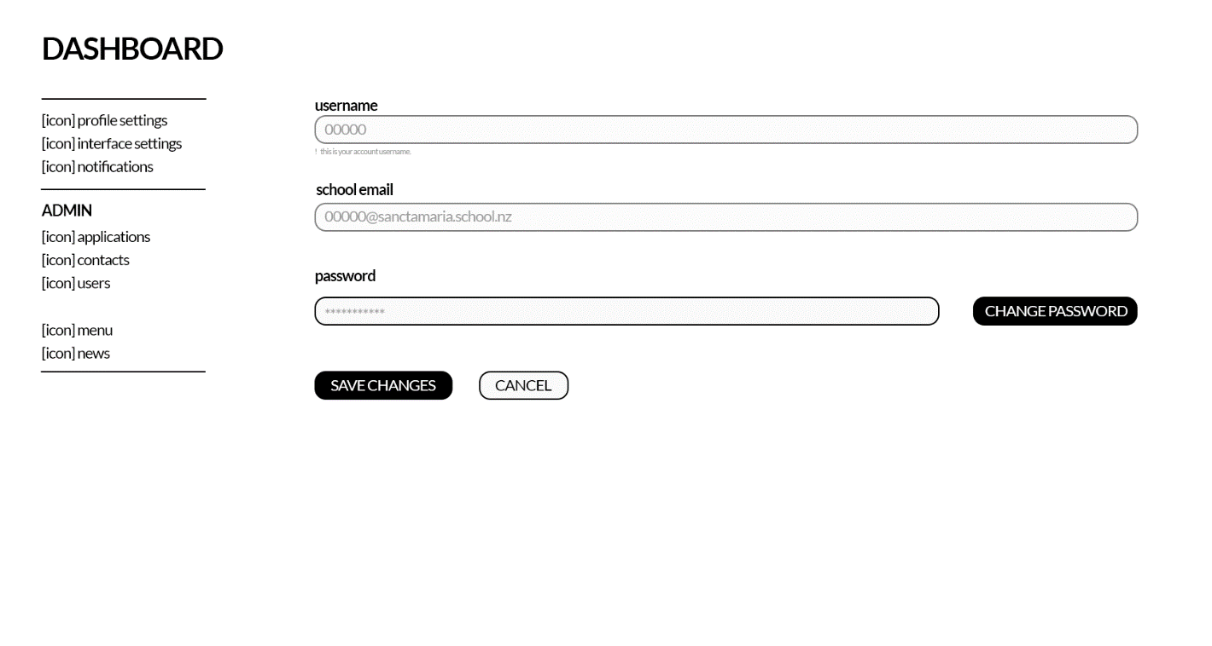
CONCEPTUAL DESIGN
WEBSITE DESIGN
WEBPAGES : WIREFRAME – DASHBOARD
[Subject to Change]

Slide 53
DEVELOPMENT : TESTING

Slide 54
TEST PLAN
How are you going test your program
to ensure it functions correctly
That the python code is PEP8 compliant
for validation and error correction
Is well structured
Is flexible and robust
Comprehensively tested and debugged

Slide 55
TEST RESULTS
Summarise the results of your testing and how you addressed any issues or problems that arise during testing. Make sure you get others to test your site and get feedback.

Slide 56
USER REQUIREMENTS
Describe how the chosen tools and techniques to develop the website were appropriate for the purpose and end users.

Slide 57
ITERATIVE IMPROVEMENT
Show how you have used iterative improvement throughout the design, development and testing process to produce a high-quality outcome. (through providing screenshots/a screencast)

Slide 58
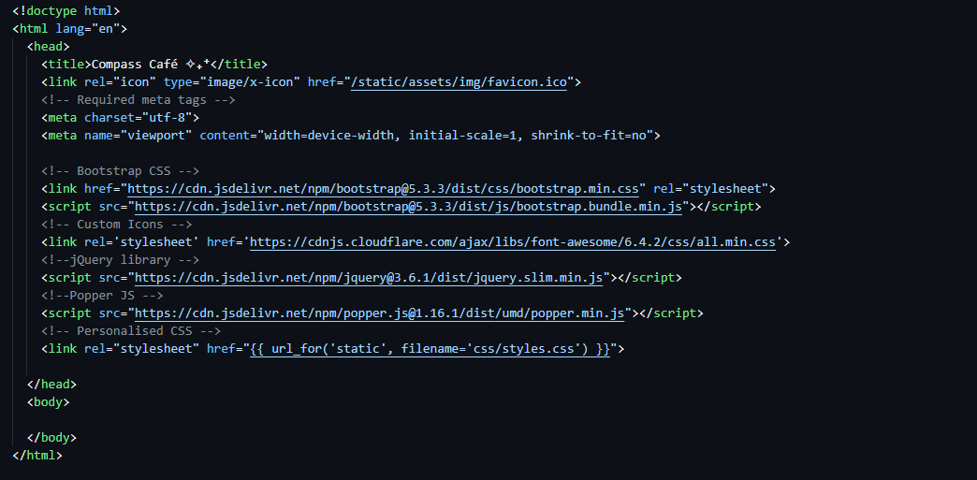
ITERATIVE IMPROVEMENT
WEBSITE DEVELOPMENT
TEMPLATE : NAVBAR
Pasted template code from practice assessment website.
Added favicon + title.

Slide 59
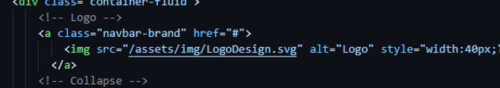
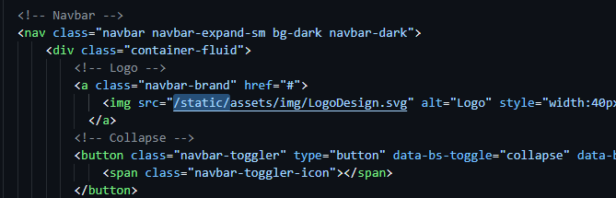
ITERATIVE IMPROVEMENT
WEBSITE DEVELOPMENT
TEMPLATE : NAVBAR
Here I have the default Bootstrap navbar with its own style. I found that my own images and CSS stylesheet do not work as usual when dealing with these local servers.
I found that by putting all these folders in a /static folder, my images and stylesheet changes can be viewed to overwrite Bootstrap’s.
For now, I will not be making this navbar sticky as I have another idea in mind.

Slide 60

ITERATIVE IMPROVEMENT
WEBSITE DEVELOPMENT
TEMPLATE : NAVBAR
A design flaw I can see is that with any background, the logo seems to blend in and does not stand out as much.
So, I put a white circle around it using Photoshop, which I think is more visually appealing.

Slide 61


ITERATIVE IMPROVEMENT
WEBSITE DEVELOPMENT
TEMPLATE : NAVBAR
I want to put the text to the right of the viewport, so it balances more with the logo on the left.
This was simply done by putting “ms-auto” next to the “navbar-nav” class.

Slide 62

ITERATIVE IMPROVEMENT
WEBSITE DEVELOPMENT
TEMPLATE : NAVBAR
Changed background to transparent.
Stylised Navbar Links.
[Note: Styles are subject to change]

Slide 63



ITERATIVE IMPROVEMENT
WEBSITE DEVELOPMENT
TEMPLATE : NAVBAR
I thought to make it a bit more interactive, I added an animation to the icon upon hovering. However, the animation resets even while still hovering.
Later then fixed by adding “forwards” to the animation property. I also found out that it will reset its transform even with “forwards”, if the animation does not reach up to 100%.
I realised that when exiting hover, the logo resets abruptly with no animation.

Slide 64


ITERATIVE IMPROVEMENT
WEBSITE DEVELOPMENT
TEMPLATE : NAVBAR
I fixed the unhover animation by simply creating an animation for the non-hover class. This way it allows for a seamless transition when interacting with the logo.
However, a persisting issue that comes with this is that the animation glitches as the cursor is just within reach of the logo, until it is not when the animation triggers.

Slide 65

ITERATIVE IMPROVEMENT
WEBSITE DEVELOPMENT
TEMPLATE : NAVBAR
I was able to fix this by using the “transform” property instead of “top” – transform allows for the object to be moved virtually without moving itself – hence how I was able to make the glitch less prominent.

Slide 66



ITERATIVE IMPROVEMENT
WEBSITE DEVELOPMENT
TEMPLATE : NAVBAR
I now want to change the logo while hovering over it for fun (animation playing same time). The issue with this is that now “position” properties are overwriting each other between “absolute” and “relative” – giving it the look that it’s appearing next to the compass logo instead of on top of it.

Slide 67




ITERATIVE IMPROVEMENT
WEBSITE DEVELOPMENT
TEMPLATE : NAVBAR
I found that having set dimensions (70px) on a parent div as the image makes it so that the logo does not shift on hover. This means setting the parent div to “relative” position while the images themselves are “absolute” so that they overlap – at the same time not overwriting each other.

Slide 68





ITERATIVE IMPROVEMENT
WEBSITE DEVELOPMENT
TEMPLATE : NAVBAR
As a placeholder, I set a profile icon from “Font Awesome”, as I think that it stands out more as a dropdown in comparison to the regular navbar links.
Profile Icon [Temporary]
This is subject to change into a customisable profile picture – though there may be no use case.

Slide 69



ITERATIVE IMPROVEMENT
WEBSITE DEVELOPMENT
TEMPLATE : NAVBAR
Dropdown [Temporary]
As of now, I’m not quite fond to Bootstrap’s default dropdown interface – compared to how it would look with the rest of the website’s design.
This is subject to change into a dropdown menu that takes up the whole side like GitHub, which is slightly different than my initial design.

Slide 70


ITERATIVE IMPROVEMENT
WEBSITE DEVELOPMENT
TEMPLATE : NAVBAR
Hamburger menu can’t be seen against the white background when viewport is collapsed. I will have to set the navbar background temporarily to see what we’re working with – for some reason, it’s still invisible.

Slide 71


ITERATIVE IMPROVEMENT
WEBSITE DEVELOPMENT
TEMPLATE : NAVBAR
Now seems to work after changing Bootstrap to a later version.

Slide 72


ITERATIVE IMPROVEMENT
WEBSITE DEVELOPMENT
TEMPLATE : NAVBAR
Now I have to change the navbar back to transparent – hamburger menu is working but I don’t like the look of it.
I also think that the profile icon should be next to the hamburger menu, similar to GitHub where profile settings is on the navbar.

Slide 73


ITERATIVE IMPROVEMENT
WEBSITE DEVELOPMENT
TEMPLATE : NAVBAR
I got it to work by ungrouping the dropdown menu from the rest of the links, so that way it is not affected by the hamburger menu dropdown.

Slide 74

ITERATIVE IMPROVEMENT
WEBSITE DEVELOPMENT
TEMPLATE : NAVBAR
All works fine until the viewport is collapsed, which then the hamburger menu is on the most right instead of the profile icon.
I need the profile icon to be on the most right.

Slide 75


ITERATIVE IMPROVEMENT
WEBSITE DEVELOPMENT
TEMPLATE : NAVBAR
This is simply fixed by ensuring that the CSS styles I configure are only affected by a certain viewport size – then shifted the profile behind the hamburger menu and aligning them altogether to match the margins of the logo on the left.
Interface Navbar Design
[Subject to Change]

Slide 76


ITERATIVE IMPROVEMENT
WEBSITE DEVELOPMENT
TEMPLATE : NAVBAR
Using my previous year’s website’s code, I created an underlined expand effect on hover, saving me a lot of time – I also pasted this code onto the footer links.
[I still have to apply this on the compact form of my navbar.]

Slide 77


ITERATIVE IMPROVEMENT
WEBSITE DEVELOPMENT
TEMPLATE : FOOTER
Using Bootstrap’s classes, I started creating the footer by using a container that spans the whole viewport width, to which I created 2 columns in 1 row.
Following my design, the footer will follow symmetry.

Slide 78


ITERATIVE IMPROVEMENT
WEBSITE DEVELOPMENT
TEMPLATE : FOOTER
Similar with the Navbar and with the help of past projects (to speed up the process), I used <ul> and <li> to position Navbar as designed in my conceptual design.
[HTML]

Slide 79



ITERATIVE IMPROVEMENT
WEBSITE DEVELOPMENT
TEMPLATE : FOOTER
Similar with the Navbar and with the help of past projects (to speed up the process), I used <ul> and <li> to position Navbar as designed in my conceptual design.
[CSS]

Slide 80



ITERATIVE IMPROVEMENT
WEBSITE DEVELOPMENT
TEMPLATE : FOOTER
I created a lower footer (black) right underneath the upper footer (blue), though I want it to appear in a fixed position after scrolling past the upper footer – almost like a parallax effect or a curtain reveal.

Slide 81


ITERATIVE IMPROVEMENT
WEBSITE DEVELOPMENT
TEMPLATE : FOOTER
First, I tried setting the lower footer to a “position” property with a “fixed” value – it is working as I intended as a curtain effect while scrolling – though I would only like for it to show past the upper footer so that the fixed lower footer does not cover anything above it. I realise I cannot put an overflow hidden on a fixed object – i.e. purple has “overflow-y: hidden;” applied to it, when img has “position: fixed;” – they clash and do not work for some reason.

Slide 82


ITERATIVE IMPROVEMENT
WEBSITE DEVELOPMENT
TEMPLATE : FOOTER
However, I did end up making it work, but at the cost of slightly altering the navbar and the background. First, I made sure that the lower footer is below everything (negative z-index) and added a background colour to cover the fixed footer. However, the background was not seeping underneath the navbar which is what I wanted, but it is in the way.

Slide 83


ITERATIVE IMPROVEMENT
WEBSITE DEVELOPMENT
TEMPLATE : FOOTER
As ms-auto no longer works after setting the navbar to “position: absolute;” so that the background can seep underneath, I had set the right side of the navbar to flex display with flex-end justification (same with the footer) so that it can be back in its original state while the background colour is overlapped by the navbar.

Slide 84



ITERATIVE IMPROVEMENT
WEBSITE DEVELOPMENT
TEMPLATE : GENERAL
Removed scrollbar visually – kept its functionality – I found that the website looks slightly off-balanced because the scrollbar creates a tiny gap, especially with darker backgrounds.

Slide 85



ITERATIVE IMPROVEMENT
WEBSITE DEVELOPMENT
TEMPLATE : GENERAL
Adding smooth scrolling using Lenis’ smooth scroll library to slightly improve the overall experience. Additionally, I’ve added other libraries (GSAP and scrolling trigger animations) to have the same effect – all just for fun.
However, I noticed that there’s a delay in scrolling once added the Lenis smooth scrolling effect.

Slide 86



ITERATIVE IMPROVEMENT
WEBSITE DEVELOPMENT
TEMPLATE : GENERAL
I found that most browsers have an experimental feature called “Smooth Scrolling”, which is clashing with Lenis smooth scroll. Lenis smooth scrolling worked after disabling the “Smooth Scrolling” experimental feature – but I simply cannot do this to consider the experience of other users.
So instead, I disabled the browser’s native scroll feature to enable Lenis buttery-smooth scroll – made sure to use !important to override the experimental feature.

Slide 87


ITERATIVE IMPROVEMENT
WEBSITE DEVELOPMENT
TEMPLATE : GENERAL
I took inspiration from other websites and wanted a button that jumps the user to the top of the website from where they are currently scrolled on the page. First, I used W3School’s jump button as a starter to see how things go.

Slide 88

ITERATIVE IMPROVEMENT
WEBSITE DEVELOPMENT
TEMPLATE : GENERAL
I didn’t like how the button jumps the user to the top rather than do a scroll transition all the way to the top, as it could possibly be that the user is confused to what happened with something that happened abruptly.
Hence why I had added the “smooth” behaviour so that it properly scrolls then jumps to the top.

Slide 89




ITERATIVE IMPROVEMENT
WEBSITE DEVELOPMENT
TEMPLATE : GENERAL
I wanted to create a bit of seamlessness; therefore, I added an animation every time it popped up or down. I replaced the individual style display properties with CSS classes, which then I can animate them going in and out of viewport frame.

Slide 90




ITERATIVE IMPROVEMENT
WEBSITE DEVELOPMENT
TEMPLATE : GENERAL
I wanted to add a bit of style to the notice banner at the top so it could stand out a bit. I made an infinite marquee by having 2 sets that sells the illusion that it is in fact infinite and created an animation that is synced.
I fixed the horizontal scrolling issue by applying a hidden overflow-x. I made it truly infinite by setting the margin (gap between text) to vw (viewport width) instead of pixels, which that way It never runs out of text to run through.

Slide 91



ITERATIVE IMPROVEMENT
WEBSITE DEVELOPMENT
TEMPLATE : GENERAL
Although it adds style to the website, users may find it hard to read the text before interacting with it – hence why I wanted the animation to stop upon hover. However, I found that it only stops the animation of the 1st set while the 2nd set continues moving, thus breaking the notice banner.
I fixed this by applying the stop hover effect on the parent container, where both sets are included, thus stopping both at the same time upon hovering.

Slide 92

ITERATIVE IMPROVEMENT
WEBSITE DEVELOPMENT
USER : VIEWS
I used practice assessment’s code to create webpage directs for my html – this time adding more webpages and tagging them with “@login_required” wherever necessary. Although I have created views for the webpages, I would still need to create them for user actions and authentication (user login and registry).

Slide 93




ITERATIVE IMPROVEMENT
WEBSITE DEVELOPMENT
USER : SIGN UP
To speed up the process of creating a sign up and login page, I used my practice assessment’s code to have the barebones of creating an account on a website.

Slide 94


ITERATIVE IMPROVEMENT
WEBSITE DEVELOPMENT
USER : SIGN UP
In the register page, I changed the username to be school ID so that students can be identified through that matter (or email) – instead of setting the type as “text”, I set it as “number” with a min of “10000” and max “99999” to have 5-digits – school ID.
I’ve also created a button for users if they have an existing account.
I pasted this onto my website and did a few styling to match the aesthetic.

Slide 95

ITERATIVE IMPROVEMENT
WEBSITE DEVELOPMENT
USER : LOGIN
For the most part, the log in page is identical to the practice assessment input with an email and password. I’ve also put a button for users to create an account if they haven’t already.
I pasted this onto my website and did a few styling to match the aesthetic.

Slide 96
ITERATIVE IMPROVEMENT
WEBSITE DEVELOPMENT
TEMPLATE : HOME - HERO
Creating a 3d effect with Spline.

Slide 97
VERSION CONTROL
Show how you have used version control throughout the design, development, and testing process.

Slide 98
GITHUB COMMITS
Show how you have used GitHub throughout the design, development, and testing process.

Slide 99
CONCLUSION

Slide 100
ADDRESSING RELEVANT IMPLICATIONS
Discuss how have you addressed relevant implications?

Slide 101
PRIVACY
IMPLICATION 01
Discuss how have you addressed relevant implications?

Slide 102
USABILITY
IMPLICATION 02
Discuss how have you addressed relevant implications?

Slide 103
FUNCTIONALITY
IMPLICATION 03
Discuss how have you addressed relevant implications?

